Slide 1
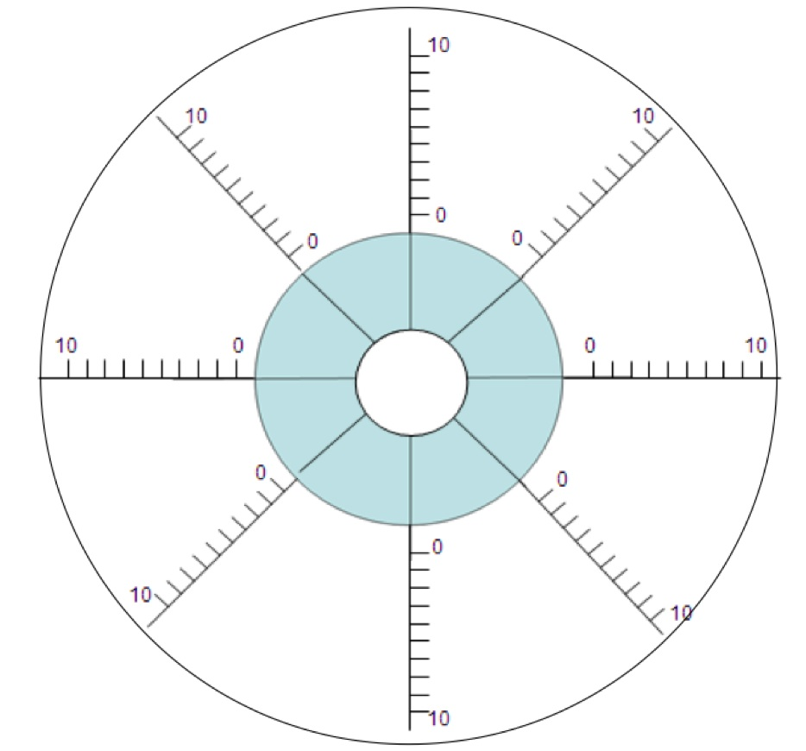
Communication
Confidence
Work relationships
Planning
Priorities
Managers
Deadlines
Workload

