Slide 1
HDN Staff Mentoring Programme Y&H Mentoring Class 4 Moving Forward 26th April 2018 Housing Diversity Network @HDN_UK

Slide 2
Key dates
Class One “Getting to know you” | Thursday 9th Nov (9.30 -4pm) Thirteen Housing Group Middlesbrough
Class Two “Understand your environment” | Thursday 8th Feb 2018 (9.30 -4pm) Broadacres Northallerton
Class Three “Challenges & opportunities” | Thursday 15th March 2018(9.30 -4pm) Broadacres Northallerton
Class Four “Moving forward” | Thursday 26th April 2018 (9.30 -4pm) Leeds Federated Housing Association Leeds
National Conference: 20th June 2018, Birmingham
Notes:
Mentors welcome to attend any classes, even just for part of the day or just to network over lunch!
Some mentors facilitate or speak at classes.
Not designed to be training courses but to give a “bitesize” look at various topics with signposts to more information if they want to.
Go through topics that might be covered in classes.
Go through the topics highlighted in forms as popular.

Slide 3
Remember…
What we’ve previously covered ?
What you have you applied from last workshop ?
Mentor session
The Celebration/Conference Reply

Slide 4
Mentoring Class Four Moving Forward
Morning 9.45 – 12.30pm
Introduction – Stephen Blundell, LFHA
Presentations
Leeds Community Homes – Jonathan Lindh
LUNCH 12.30 – 1.15pm – Networking
Afternoon 1.15 – 4.00pm
CVs and Interviews – making a positive impact
Questions and Answers– Megan Henderson LFHA
Moving Forward
Celebration/Conference - Presentation
Notes:
Let’s get started – this is what we are covering today.
Mentee intro’s & something interesting about themselves that links to a challenge or opportunity!
Ground rules up there!

Slide 5
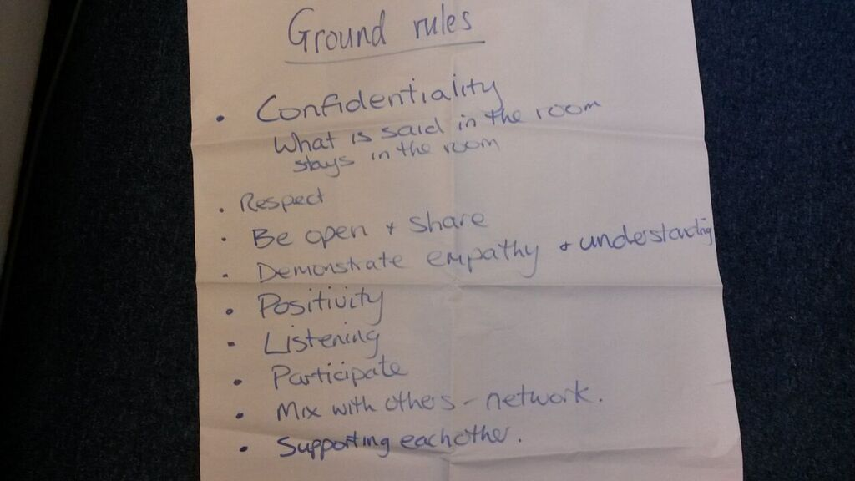
Welcome to Class Four
Confidential
Listen
Positivity
Respect each other
Be open, share & participate
Network

Slide 6
Stephen Blundell Director of Operations
Leeds Federated Housing Association

Slide 7
BREAK !

Slide 8
People’s top 10 fears
Fear of flying
Fear of public speaking
Fear of heights
Fear of the dark
Fear of intimacy
Fear of death
Fear of failure
Fear of rejection
Fear of spiders
Fear of commitment

Slide 9
Positive Feedback
Learn the objectives of the presenter
Consider the skill level of the presenter
Be truthful
Express your opinion
Avoid absolute statements
Be specific – use examples
Don’t evaluate the person
Was the objective achieved ?

Slide 10
Positive Feedback
‘How did you feel about that ?’
Topic and technical depth
Slide design
Narrative
Presentation style

Slide 11
Getting feedback is difficult
‘Ask for a slap in the face’ (Paul Arden)
‘I always wanted to be somebody: now I realise I should have been more specific’ ( Lily Tomlin)
‘If you have no critics, you’re likely to have no success’ (Malcolm X)

Slide 12
Presentations
Karen McCaughey
Claire Henderson
Jamie Jones
Gavin Houghton
Karen McClarence
Chloe Thompson

Slide 13
It’s Lunch Time!

Slide 14
Curriculum Vitae
Learning to market yourself
Why do you need a CV ?
Who needs a CV ?
When do we need a CV ?

Slide 15
Making a CV work for you
Personal details
Education
Training received
Work history
Skills you possess

Slide 16
Other details
Age and Marital Status
Addresses of where you have worked
Hobbies and interests
References

Slide 17
Definition of a CV
‘A CV is your sales document that highlights your skills, achievements and experience in a way that the reader is motivated to meet you’
It is a SELLING document

Slide 18
How to sell yourself in 30 seconds
Profile – your banner headline
Gives a brief overview of who you are
Highlights your main skills and experience
Communicates personal attributes
Motivates the reader to know more
Should consist of 30-50 words

Slide 19
Profile example
‘An accomplished and qualified business and management trainer, who quickly develops rapport with people. Dynamic and humorous approach helps create a stimulating learning environment. Maintains complete professionalism in all business matters’

Slide 20
Profile Exercise
On your own highlight all the words that best describe you
In pairs help each other to narrow down to the 10 words that best describe you
On your own have a go at writing your profile using these 10 words within 30-50 words
In pairs see if you can improve the profile

Slide 21
Presenting your career history
What you have done
For how long
What you achieved
What skills you developed

Slide 22
Common Mistakes
Include irrelevant information
Write a lengthy job description
Use jargon
= Rejection

Slide 23
STAR
Situation
Result
Task
Action
Notes:
Used widely in public sector – very specific requests for information in 300 words per competency. This is not overly informative or helpful.
Useful tool to help you consider your examples and aid your application or preparation for interview.
Situation – give a background to what you are going to talk about / why. CG forgot to actually say in one interview what her current job was and what it invovled.
Task – what was required / expected / what were you were towards?
Action/achievement – what you did / what actions you took and why
Result – Outcome. Be specific! Give cost savings, percentages – know your information.

Slide 24
Achievements exercise
In pairs help each other complete the exercise looking at your current job and your achievements in it. Try to find quantifiable achievements e.g. reduced rent arrears by 10 % over a six month period

Slide 25
Megan Henderson
HR Manager
Leeds Federated Housing Association
Questions and Answers

Slide 26
BREAK !

Slide 27
Conference planning
Who’s coming?
Who’s presenting?
How else can you contribute as a group together?
Any questions?

Slide 28
Review of the day
On post its write 3 things:
What went well today
What one opportunity will you take to increase your personal impact/PR?
What will you do next to continue to reach your objectives/goals?

Slide 29
Thank you
E: camilla@housingdiversitynetwork.co.uk
T: 07791488196
W: housingdiversitynetwork.co.uk
Camilla Veale
Mentoring Co-ordinator
@HDN_UK

