Slide 1

HDN Staff Mentoring Programme
Midlands Mentoring Class 4
Moving Forward
29th May 2019
Housing Diversity Network
@HDN_UK
WELCOME BACK!!

Slide 2
Mentoring Class Four
Moving Forward
Morning 9.45 – 12.30pm
Introduction / Looking Back
Presentations, Presentation Skills
Housing Sector Change & Impact – Sioux Breeze Derrigan,
LUNCH 12.30 – 1.15pm – Networking
Afternoon 1.15 – 4.30pm
CVs and Interviews – making a positive impact
Questions and Answers– Surgery
Moving Forward
Celebration/Conference - Presentation
Notes:
Let’s get started – this is what we are covering today.
Mentee intro’s & something interesting about themselves that links to a challenge or opportunity!
Ground rules up there!

Slide 3
Remember…
What we’ve previously covered ?
What have you applied from last workshop ?
Your Mentor sessions?
Your Celebration/Conference Reply?
Ground Rules

Slide 4
Key dates
Briefing Class One “Getting to know you” | Weds 28th November 2018 EMH Homes Leicester
Class Two “Understand your environment” | Thurs 31st January 2019 Stonewater Coventry
Class Three “Challenges & opportunities” | Tues 26th March 2019 PARAGON ASRA Leicester
Class Four “Moving forward” | Weds 29th May 2019 Rooftop Housing Evesham
National Conference: 20th June 2019 Birmingham
Notes:
Mentors welcome to attend any classes, even just for part of the day or just to network over lunch!
Some mentors facilitate or speak at classes.
Not designed to be training courses but to give a “bitesize” look at various topics with signposts to more information if they want to.
Go through topics that might be covered in classes.
Go through the topics highlighted in forms as popular.

Slide 5
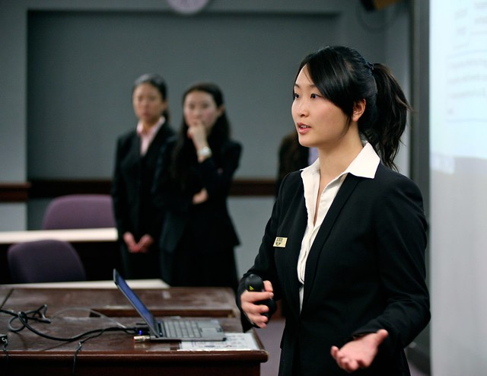
Conference Planning
Who’s coming?
Who’s presenting?
How else can you
Contribute?
What needs doing?
Any questions?
This Photo by Unknown Author is licensed under CC BY-NC-ND
Notes:
Content and Delivery!
Ground rules up there!

Slide 6
Positive Feedback
‘How did you feel about that ?’
Topic and technical depth
Slide design
Narrative
Presentation style

Slide 7
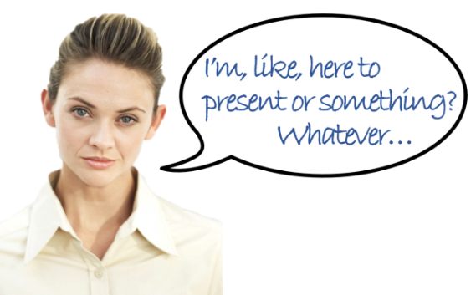
Developing Personal Presence and Impact

Slide 8
Reflection – pre-work
Question 1 What three words would you want others to use to describe you after meeting you for the first time? | Question 2 How would you want to make people feel about you?

Slide 9
People’s top 10 fears
Fear of flying
Fear of public speaking
Fear of heights
Fear of the dark
Fear of intimacy
Fear of death
Fear of failure
Fear of rejection
Fear of spiders
Fear of commitment

Slide 10
Positive Feedback
Learn the objectives of the presenter
Consider the skill level of the presenter
Be truthful
Express your opinion
Avoid absolute statements
Be specific – use examples
Don’t evaluate the person
Was the objective achieved ?

Slide 11
Getting feedback is difficult
‘Ask for a slap in the face’ (Paul Arden)
‘I always wanted to be somebody: now I realise I should have been more specific’ ( Lily Tomlin)
‘If you have no critics, you’re likely to have no success’ (Malcolm X)

Slide 12

COMFORT BREAK !

Slide 13
Sioux Breeze Derrigan
Learning and
Organisational Development Manager
Guest Speaker:
Rooftop Housing

Slide 14

It’s Lunch Time!

Slide 15
Presenters

Slide 16
Curriculum Vitae
Learning to market yourself
Why do you need a CV ?
Who needs a CV ?
When do we need a CV ?

Slide 17
Making a CV work for you
Personal Statement
Key Skills
Achievements

Slide 18
Other details
Age and Marital Status
Addresses of where you have worked
Hobbies and interests
References

Slide 19
Definition of a CV
‘A CV is your sales document that highlights your skills, achievements and experience in a way that the reader is motivated to meet you’
It is a SELLING document

Slide 20
How to sell yourself in 30 seconds
Profile – your banner headline
Gives a brief overview of who you are
Highlights your main skills and experience
Communicates personal attributes
Motivates the reader to know more
Should consist of 30-50 words

Slide 21
Profile example
‘An accomplished and qualified business and management trainer, who quickly develops rapport with people. Dynamic and humorous approach helps create a stimulating learning environment. Maintains complete professionalism in all business matters’

Slide 22
Profile Exercise
On your own highlight all the words that best describe you
In pairs help each other to narrow down to the 10 words that best describe you
On your own have a go at writing your profile using these 10 words within 30-50 words
In pairs see if you can improve the profile

Slide 23
Presenting your career history
What you have done
For how long
What you achieved
What skills you developed

Slide 24
Common Mistakes
Include irrelevant information
Write a lengthy job description
Use jargon
= Rejection

Slide 25
BREAK !

Slide 26

STAR
Situation
Result
Task
Action
Notes:
Used widely in public sector – very specific requests for information in 300 words per competency. This is not overly informative or helpful.
Useful tool to help you consider your examples and aid your application or preparation for interview.
Situation – give a background to what you are going to talk about / why. CG forgot to actually say in one interview what her current job was and what it invovled.
Task – what was required / expected / what were you were towards?
Action/achievement – what you did / what actions you took and why
Result – Outcome. Be specific! Give cost savings, percentages – know your information.

Slide 27
Achievements exercise
In pairs help each other complete the exercise looking at your current job and your achievements in it. Try to find quantifiable achievements e.g. reduced rent arrears by 10 % over a six month period

Slide 28
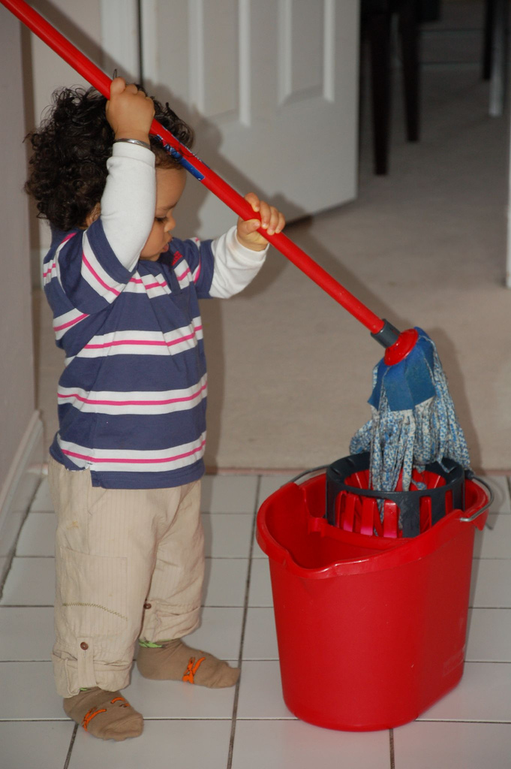
Questions and Answers
Workshop 4
Mop Up
This Photo by Unknown Author is licensed under CC BY-SA

Slide 29
Review of the day
On post its write 3 things:
What went well today
What one opportunity will you take to increase your personal impact/PR?
What will you do next to continue to reach your objectives/goals?

Slide 30
Thank you and Good Luck for the Future!
E: moreen@housingdiversitynetwork.co.uk
W: housingdiversitynetwork.co.uk
Moreen Pascal
Programmes Manager
@HDN_UK

Slide 31
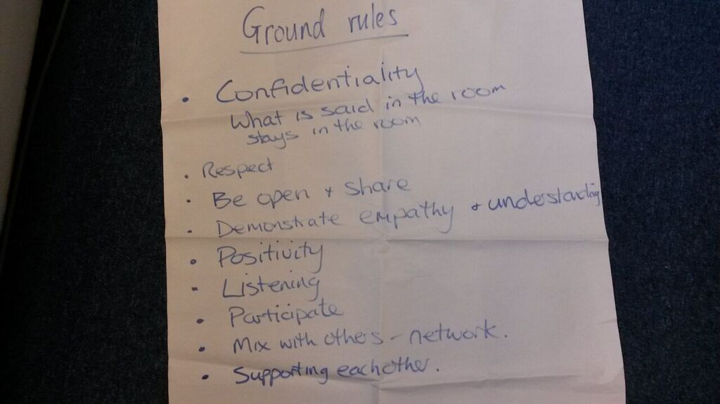
Welcome to Class Four
Confidential
Listen
Positivity
Respect each other
Be open, share & participate
Network

