Slide 1
London Mentoring Class Four
Moving Forward/ Celebrating Success
May 2019

Slide 2
Welcome to Class Four – Moving forward
Introductions and house keeping
How we will work today – roles and ground rules
Today is about bringing all the programme threads together to build confidence in presenting your skills and achievements, and to share and celebrate your success

Slide 3
Mentoring Class Four-Moving forward
Objectives
To build self-awareness of presence and impact
To build confidence in evidencing achievement in applications, interviews and appraisals
To share learning and plan next steps
Activities
Developing Personal presence and impact – how do I come across?
CV – who am I and what do I bring?
Presenting your skills and achievements (STARs)
Reflecting on and presenting our learning journey
What I will do next……..

Slide 4
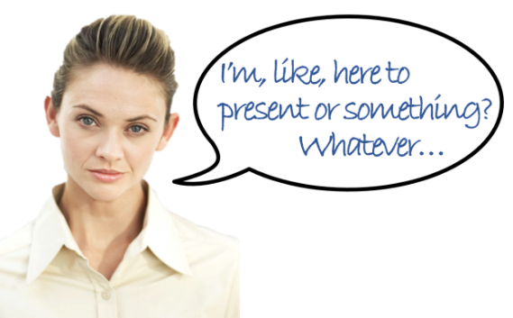
Developing Personal Presence and Impact

Slide 5
Learning outcomes
By the end of the session we’ll have:
Built an understanding and awareness of the way we come across
Increased our awareness of the impact this has
Ideas to practise and apply our knowledge to a variety of situations.

Slide 6
Identifying personal presence and impact
What words come to mind when you’re thinking about personal presence and impact?
(In other words, what do we think contributes to a positive personal presence and impact?)

Slide 7
Reflection and projection
People will forget what you said, People will forget what you did,
But
People will never forget How you made them feel.
Maya Angelou

Slide 8
Reflection – pre-work
Question 1 What three words would you want others to use to describe you after meeting you for the first time? | Question 2 How would you want to make people feel about you?

Slide 9
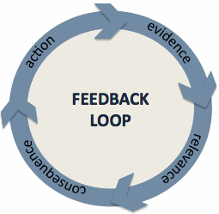
A few words about feedback…
Feedback should be given and received WITH respect and WITHOUT judgement.

Slide 10
Reality activity
Think back to when you first met and take turns to share your first impressions, include:
Three or four words describing your first impression
How they made you feel.
Once feedback received, share what you wrote down on your pre-work.
Discuss the differences / similarities you are seeing and hearing.

Slide 11
Learning outcomes
By the end of the session we’ll have:
Built an understanding and awareness of the way we come across
Increased our awareness of the impact this has
Ideas to practise and apply our knowledge to a variety of situations.

Slide 12
Coffee Break

Slide 13
Presenting myself – who am I and what do I bring
CVs (before lunch)
STARs (after lunch)

Slide 14
CVs
What is a CV?
What’s the purpose of a CV?
What are the key ingredients of a good CV?
What will make your CV stand out (or get rejected?)
Why do some organisations or jobs ask for a CV and others an application form? What’s the difference?

Slide 15
Building your CV?
A concise overview of your transferable skills and achievements that encourages interest to meet you and find out more…
Profile: Who I am; what I bring; what I am looking for
Key skills
Achievements you are proud of

Slide 16
CV Peer Review – ‘critical friend’
Working in pairs, look at each others CV focussing on the profile and first impressions
What overall impression does the CV convey of the mentee
Profile – how would the mentee like to be seen (think back to earlier session)? Does the profile convey this
What makes the CV successful?
Actions to develop CV

Slide 17
Reminder about feedback…
Feedback should be given and received WITH respect and WITHOUT judgement.

Slide 18
Review and next steps
What worked well, made a difference?
Example profile?
Summary dos and don’ts – CVs and personal statements/application forms
Learning and actions – post its/ PDL

Slide 19
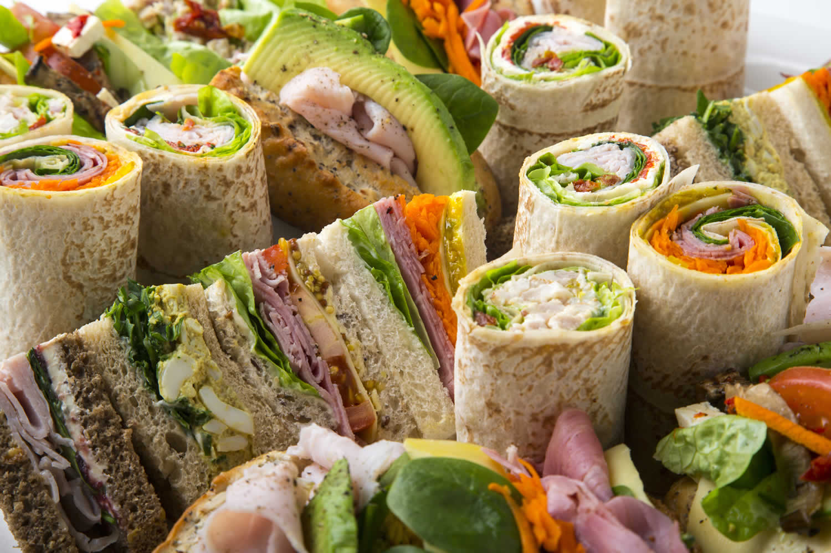
Lunch

Slide 20
Presenting Your Achievements

Slide 21
Presenting my skills and achievements
Recap of STARs Situation – Task – Action - Results
Link to CVs, application forms, interviews, appraisals
Giving Feedback
Skills practice

Slide 22
STARs
S = Situation (The ‘Why’) Gives the context and provides meaning
T = Task (The ‘What’) Explains specifically what is the task in hand
A = Action (The ‘How’) What did you do?
R = Result (The ‘So What’) What is the objective evidence of success?
Notes:
Use of STARs
Performance and Development reviews
Job Applications internal / CV writing
Interviews
Start with an ‘interview’ STAR as it is probably the way we get the STAR on to paper before summarise it to be suitable for a CV STAR

Slide 23
STAR
Situation:
Workflow productivity targets were falling, all departments were asked to consider ways to make improvements to efficiency.
Task:
I coached a field based team member in developing his planning and time management skills.
Action:
Through working together to examine workflow activity, I identified gaps in communication and information channels. I proposed using a colour code system to categorise work and to integrate this with the department communal diary appointment booking system.
Result:
Gap analysis monitoring of the diary system and reduced phone call activity between HO’s and the field, demonstrated effective team communication was being achieved. The interdependencies between office and field-worker were better understood by the team. Resident’s expectations were being met within the SLA. The Workflow Key Performance Indicator (KPI) indicated an improvement over a 6 month period of x%

Slide 24
The Importance of the “R”
How have you made/saved the organisation money?
How have you improved productivity?
How have you increased customer satisfaction or resolved a customer issue?
How have you improved motivation and morale?
How have you improved a process or procedure?
What did you learn and how have you used this?
e.g. Skills, confidence, what you would do differently next time, further improvements etc
Notes:
Other areas:
How have you performed against targets set?
Any key projects you have delivered against
Any changes in working practices as a result of an idea you have implemented?
Promotions
Recognition Awards
Complimentary e-mails from customers, suppliers, your boss etc.

Slide 25
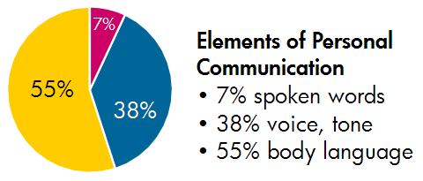
Skills practice – its not just the words……
Professor Albert Mehrabian

Slide 26
Exercise: Presenting your achievements using STAR
In trios, present a key achievement (using STAR) to your manager or a senior manager.
Before you start to present express how they would like to come across (concise, authoritative, successful) Present your example in this way
Other mentees in trio to feedback – what you said, how you said it and impact – be specific

Slide 27
Tips for positive impact in interviews and presentations
Give yourself time to prepare and relax
Put your phone in silent mode
Believe in yourself
Be positive
Breathe!
Smile and make eye contact
Use a firm handshake
Be polite and professional
Open posture / mirroring
Use notes as a prompt
Silence is okay
Ask a question!
Be aware of your habits/ nervous tendencies!
Be able to laugh at yourself
Maintain your professional persona

Slide 28
Short Break

Slide 29
Celebrating our mentoring journey

Slide 30
Presenting success
Individual:
What did I set out to achieve?
Where am I now?
What I will do next – my commitment to act

Slide 31
Presenting our success
Conference group
What do we want to present?
What will this look like?
How will we achieve this?
What else needs to happen today?
Actions before 20th June Birmingham

Slide 32
Moving forward
What is my commitment to the next step?
What support do I need?
Closing the mentoring relationship, including feedback to my mentor
Celebrating success (conference 20th June 2019)
Contributing to final evaluation
One word about how you feel now

Slide 33
Be the change you want to see

Slide 34
www.housingdiversitynetwork.co.uk
beverleyr@housingdiversitynetwork.co.uk

