Slide 1
London and SE
Mentoring Programme
2018-2019
Class 2 Understanding your environment
January 2019
Poplar Harca

Slide 2
Welcome to Class Two – Understanding Your Environment
How we will work today – Ground rules
Respect - Confidentiality
Share concerns and experiences
Open to learning – Try it out
Ask questions of each other – Supportive
Have fun

Slide 3
Understanding Your Environment
Objectives
To understand more about how you perceive others and are perceived
To consider ways to deal with challenging work relationships and situations assertively
To understand the value of personal reflection
To consider work life balance
Understanding different people and styles
The role and impact of perceptions
Managing productive relationships
Assessing work and life priorities
Reflection and PDL update

Slide 4
Understanding and using DISC
Objectives
To develop your understanding of DISC
To reflect/discuss your PPI report
To discuss how DISC styles impact perceptions of yourself and others
To reflect/discuss how to DISC styles influence and impact how you work with others.

Slide 5
Personality Profile Analysis (PPA)

Slide 6
Why do organisations use psychometric profiling and assessment tools?
Recruitment
Talent management
Personal development / leadership development
Career development
Team development
Coaching
Mentoring

Slide 7
Important things to remember
There is still a great deal we do not understand about personality i.e. nature vs nurture, the extent to which it is fixed etc.
Psychometric testing is based on a particular school of psychological thought known as ‘Trait Theory’ (Eysenck and Cattell). Critics of this theory suggest that traits are not always accurate predictors of behaviour
Just because you may not naturally enjoy an aspect of work does not mean you cannot develop a high level of competency in it
Situational and contextual factors such as how you are feeling about work on that day can affect how you complete the test and the results.
The results are only used for your personal reflection and growth – it is up to you to decide how meaningful/useful they are to you.

Slide 8
DISC – Personality Profile
D | I | S | C
Dominance | Influence | Steadiness | Compliance

Slide 9
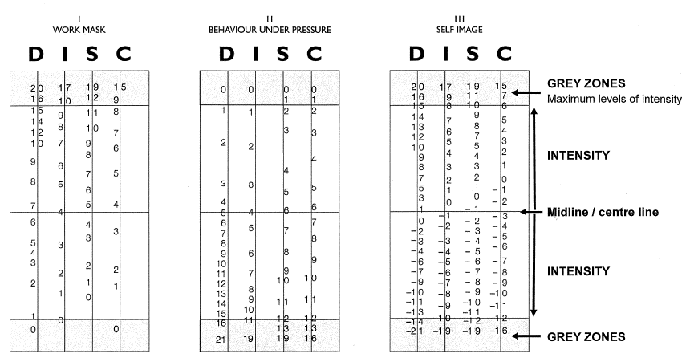
DISC – Personality Profile
Review the three Charts/Graphs:
1 - Basic Behaviour (Self-image)
2 - Potential Work Behaviour (Work mask)
3 - Behaviour under pressure (Pressure Profile)
Notes:
Explain the chart – put the DISC type into group – and discussion patterns of behaviour.

Slide 10
Group exercise
Part 1 - Strengths and weaknesses of DISC
What are the strengths of your type?
What are the weaknesses of your type?
Consider
To what extent do I match the type characteristics? What affects it?
Notes:
Once the group and reflected on this as individuals and as group- they will feedback to the whole class.

Slide 11
Group exercise
Part 2 - Opportunities and pitfalls of working with different types
Benefits and Opportunities of working with this type
How we can work best together
Notes:
Hand outs of flip chart – having the four type on two separate papers one saying opportunities and the other saying pitfalls. Provide an illustration or example of the behaviour and the impact it has. Four pieces of paper with the different type on the main heading – one type per table – if it table with Dominance – they will be given Influence and ask to provide feedback. The hope that the group will look for ways to improve their relationships with each other.
Are you working within type

Slide 12
Reflecting on DISC Managing conflict/ difficult situations
Conflict or difficult personal situation/customer you have experienced – was your style appropriate?
What was good/ less good about the way you handled it? What could you have done differently to improve the outcome?
How might knowing what style will help you in future?
Reflect 5 minutes, then discuss in trios choosing someone with a different DISC type to you.
Group review - Share one learning point and one action
Note - PDL
Notes:
Not sure about this slide might move it to later excise on Gibbs – feels like a repeated exercise.

Slide 13
Time for Lunch

Slide 14
Reflective Learning

Slide 15
What is reflection or reflective learning?
Learning from your experiences
2 stages
mental processing (thinking)
learning
What can I reflect on?
critical incidents
a period of time
an on going issue
Keeping a written record of reflection
Notes:
Look at notes on reflective learning and model to be included

Slide 16
The Learning Cycle (Kolb, Honey and Mumford)
The Activist
Do
Review
Conclude
Plan
The Pragmatist
The Reflector
The Theorist
Notes:
To break this session up – Just do a quick exercise to help the group to identify their Learning style – shopping at IKEA and setting it up at home. How do you go about it pull the box apart or read the instruction for example.

Slide 18
Gibbs Model of Reflection
Description: Concise description of your experience
Feelings: Describe how you felt
Evaluation: What went well/worked,
Don’t analyse why, just what happen
Analysis: In depth to understand why things happened and the consequences,
Conclusion: Sum up the key learning from your analysis
Action Plan: What do you need to do to be better
Notes:
Description – no analysis just details and facts. Feelings – before and after and during and how you act and behaviour. Evaluation what went badly/didn’t work, how did it end (Win/win)

Slide 19
Having influential conversations

Slide 20
Influencing
What is it?
Ability to affect another’s attitudes, beliefs or behaviours
Persuasion without force
Requires collaboration
Get results, win / win
More likely to influence what we can control
How do we influence?
Consider the personality style – DISC
Assertiveness skills
Using the DESC tool
Notes:
ASK WHAT TYPE OF INFLUENTIAL CONVERSATIONS HAVING AT WORK – me budgets (for an away day), equipment, colleagues – office cover etc. (AT HOME IF NEED BE) . Not necessarily about getting what you want as this may change but it is a win / win
We can control our reactions, emotions, behaviour, commitment, performance etc.
Want people to come along on the journey with you
We are more likely to influence what we can control and influence – the personality type we know, who are more like us. Need to flex our style.
Wrap up – need skill as you progress into leadership and working with various stakeholders, strategically need to be able to

Slide 21
Assertiveness
Relating to other people on an equal basis, openly, honestly and directly.
Having your rights whilst, at the same time, remembering that the other person has equal rights.
It does not mean winning all the time.
It does mean achieving a situation by reaching a workable agreement that doesn’t compromise your self-respect.
A real agreement between equals

Slide 22
Developing Assertiveness Behaviour
Respecting self and others
Taking responsibility for your action
Making “I” statements
Allowing for mistakes and forgiving self
Responsibility toward others not for others
Understanding others make mistakes

Slide 23
DESC scripting
Describe the situation factually
Express the impact the situation is having on you
Specify what action or change you would like
Consequences and benefits for you/ them
Notes:
Input a slide on Assertiveness – what is it why do and why we find it challenging. DESC is a tool to use to help us

Slide 24
Preparing for the conversation
Part 1
Gibbs model on Reflection – How will it help you in the future
Part 2
Think of an influential discussion you would like to have to some one.
Prepare for and practice the conversation you would like with your partner using DESC scripting
Practice - 5 mins each to write your script, 5 mins each to share/practice
Notes:
In previous exercise you thought about the way you wanted to do and now what you want to say – to influence that person.

Slide 25
Keeping a learning log
Experience | Review | Conclude | Actions
What happened | What was the result/ impact | What did I learn | What will I do

Slide 26
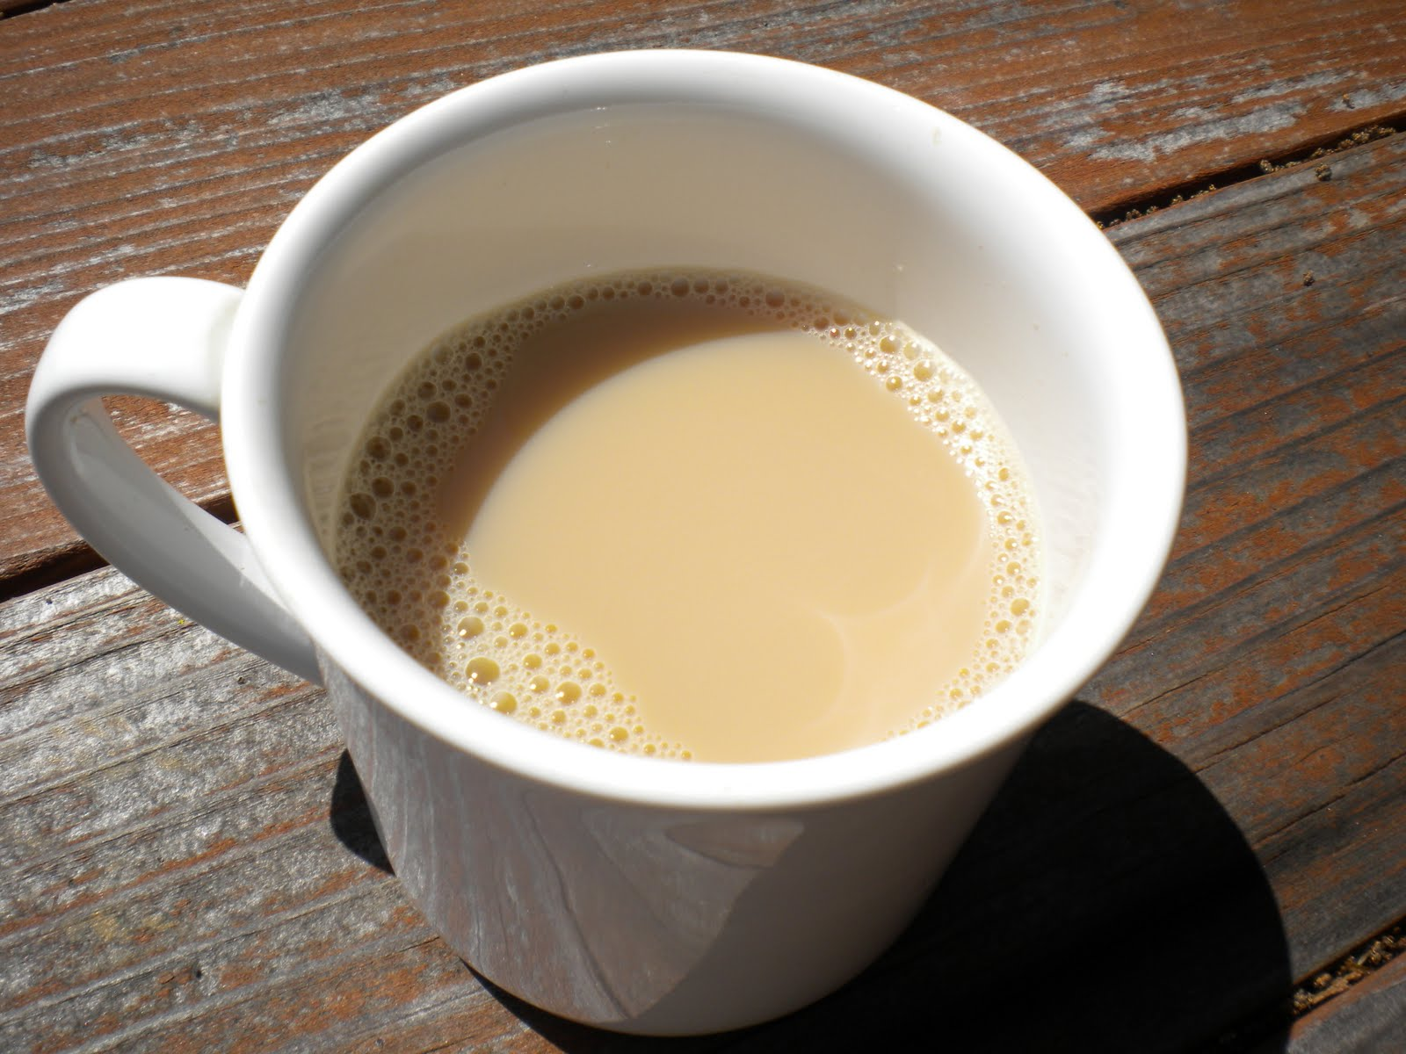
Tea Time

Slide 27
Assessing work and life priorities

Slide 28
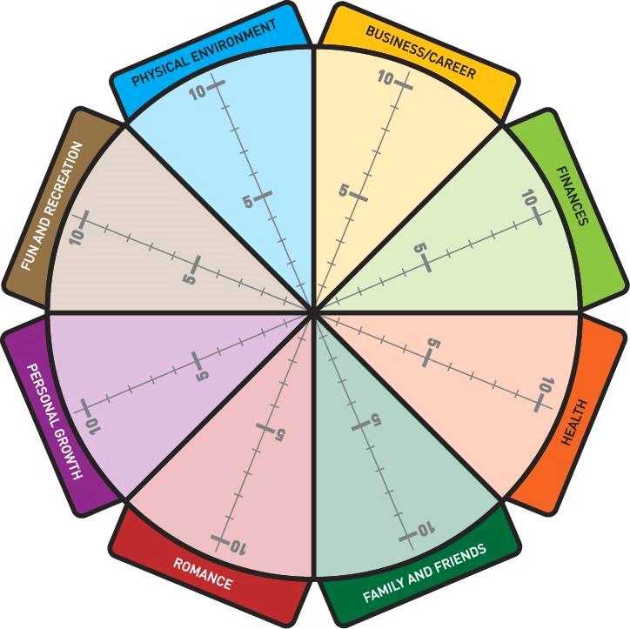
Work/life Balance
Individual Task
Complete the ‘wheel of life’ scoring yourself from 0-10 on how satisfied you are with that area of your life
0 = Poor
10 = It can’t get any better
Colour in the part of each segment which is ‘satisfied’

Slide 29
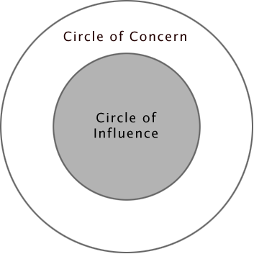
What would I like to change
Notes:
Class 1 – exercise

Slide 30
Focussing the issue
What can you do to your area of concern move it into your circle of influence
What strengths and resources you have available?
What is limiting / stopping you?
Who do you need to influence or gain support from to achieve this?
Notes:
Area of concern/influence – (this may mean reframing the problem)?
What is limiting you - (focus on internal sources)
(focus on internal sources)

Slide 31
Committing to action - Paired exercise
Where would you like to be?
In pairs, identify a realistic goal for the next month
What do I want to change and why?
How will I feel when I have achieved it/ how will I know I have been successful?
What will I do? How? When?
Who can support me/ who else will benefit?
What is my first action?
Write or draw your goal and first action on a post card – to be reviewed at class 3

Slide 32
Review of the day
& Next steps

Slide 33
Review and what next
What did you learn today?
What will you do different at work?
How can your mentor help you (planning your next mentoring session)?
Completing your PDL
Preparing for Class 3 –Committing to action
Don’t forget – STARs/ Building your CV/ Network…

Slide 34
www.housingdiversitynetwork.co.uk
01484 652606
Beverleyr@housingdiversitynetwork.co.uk
07772 356906

