Slide 1
HDN Staff Mentoring
NE and Y&H Class 2
– Wednesday 9th January 2019
@HDN_UK

Slide 2
Mentoring Class Two Understanding Your Environment
Objectives
To be aware of recent major changes in the Housing Sector
& how they impact on you
To understand more about how you perceive others and are perceived
To identify what and how you can influence/control
How we will achieve the above:
Mixture of presentations, group discussions and group exercises
Participation and contribution!

Slide 3
Key dates
Class One “Getting to know you” | Thursday 9th Nov (9.30 -4pm) Thirteen Housing Group Middlesbrough
Class Two “Understand your environment” | Thursday 8th Feb 2018 (9.30 -4pm) Broadacres Northallerton
Class Three “Challenges & opportunities” | Thursday 15th March 2018(9.30 -4pm) Broadacres Northallerton
Class Four “Moving forward” | Thursday 26th April 2018 (9.30 -4pm) Leeds Federated Housing Association Leeds
National Conference: 20th June 2018, Birmingham
Notes:
Mentors welcome to attend any classes, even just for part of the day or just to network over lunch!
Some mentors facilitate or speak at classes.
Not designed to be training courses but to give a “bitesize” look at various topics with signposts to more information if they want to.
Go through topics that might be covered in classes.
Go through the topics highlighted in forms as popular.

Slide 4
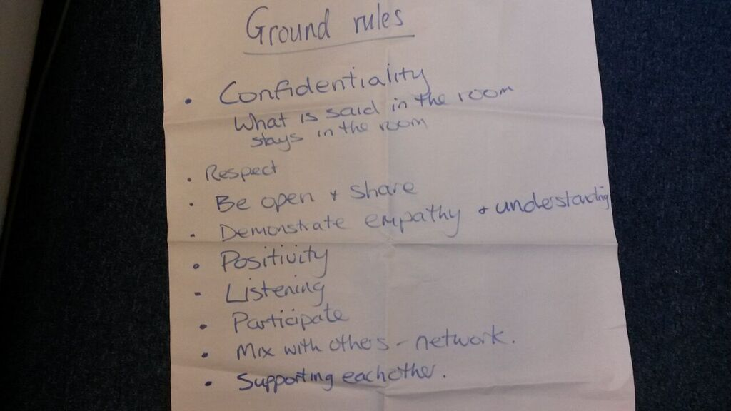
Welcome to Class Two – Your Environment
Introductions
How we will work today – roles & ground rules

Slide 5
Welcome To Broadacres
Chris Fawcett
Business Support Director and Company Secretary
Broadacres

Slide 6
BREAK

Slide 7
Understanding and using DISC
Objectives
To learn more about DISC to enable you to reflect/discuss your PPI report with your mentor – to gain insight and support your development
To use DISC styles to consider the impact of perceptions on yourself and others

Slide 8
DISC
D - Dominance
I - Influence
S - Steadiness
C - Conscientiousness

Slide 9
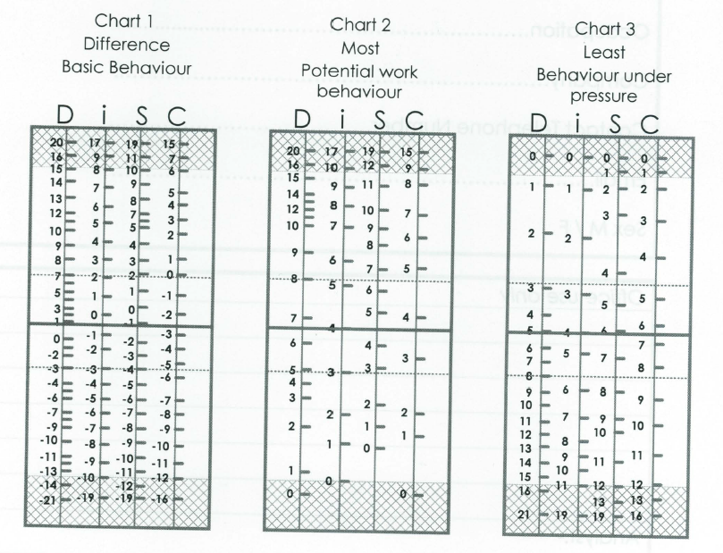
DISC – Personality Profile
Review the three Charts/Graphs:
Basic Behaviour (Self-image)
Potential Work Behaviour (Work mask)
Behaviour under extreme pressure (Pressure Profile)

Slide 10
Group exercise
Part 1 – Strengths of my type
What are your strengths (individual/ as a group/ type description)
How much are you like your type ?

Slide 11
Group exercise
Part 2- Opportunities and pitfalls of working with different types (carousel exercise)
Opportunities of working with this type
Problems and challenges of working with this type
How can you best work with this type ?

Slide 12
Exercise in Pairs
Think about a conflict or difficult personal situation/ customer you have experienced – was your style appropriate?
What was good/ less good about the way you handled it?
Knowing more about your style (and perhaps theirs?) what could you have done differently to ensure a better outcome?
How might knowing what style you tend to adopt help you in future?

Slide 13
Thank you Any questions?
It’s Lunch Time!

Slide 14
Learning from this morning
Update PDL page 12
Reflection
Note any learning
Points to follow up and explore with mentor
Any actions you will take
Notes:
Skip if need be and use in the review session!

Slide 15
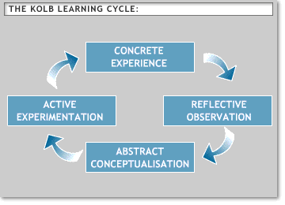
Kolb’s Learning Cycle
Notes:
Ask if any Mentee has come across the cycle before – if yes can they explain it ?
Explain Kolb’s learning cycle – Different stages
Effective learning – you go through the whole cycle.

Slide 16
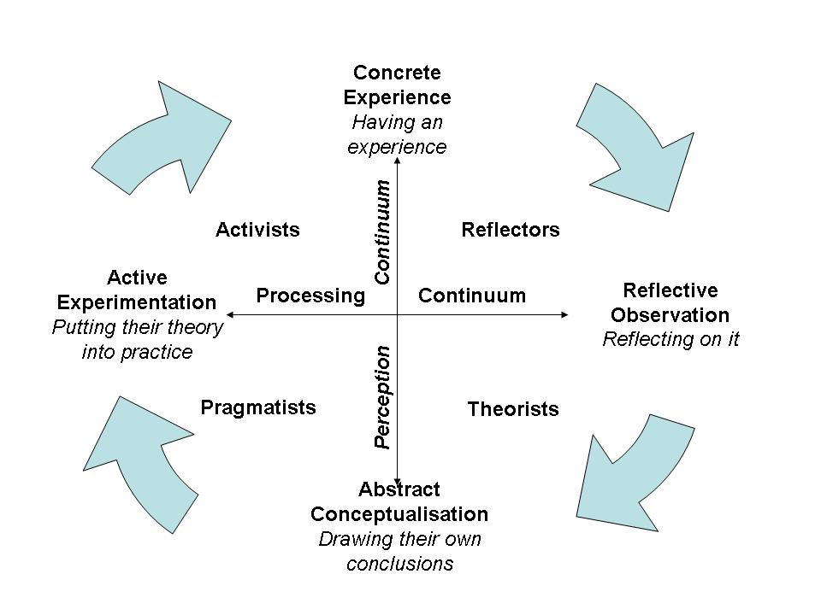
Learning Styles – Honey and Mumford
Notes:
Honey and Mumford took Kolbs cycle and identified that people have a natural preference for being
at a certain point in the learning cycle.
They identified four distinct learning styles Activists , Reflectors, Theorists and Pragmatists
Most of us tend to to follow only one or two of these styles.
Give out Learning styles questionnaires and get Mentees to complete them
Flip chart what learning style they are – initials on flipchart

Slide 17
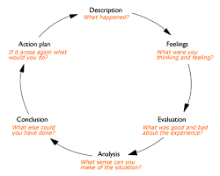
Gibbs’ model of reflection

Slide 18
Locus of Control
Questionnaire

Slide 19
How do I manage myself?
LOCUS OF CONTROL
External Locus Internal Locus
of control of control
Little responsibility for own behaviour/choices
Blames others/life for what’s wrong
Avoids coming out of comfort zone
May not do what will make things better
Reliance on others approval to make them feel good
May not learn from their mistakes
Low ability to inner reflect
Empower Yourself
Remember you always have a ‘choice’ to change your situation
Make a list of possible courses of action
Brainstorm ideas with a friend/colleague to get more ideas
Evaluate each one and decide on the best
Notice your ‘self talk’, the language you use – be positive
Remember your attitude to a problem will affect your stress levels
Takes responsibility for their actions
Does things that will change their situation for better
Works hard to develop knowledge and skills
Inquisitive & solution focused when things go wrong
Does not blame others
Self reliant for their self-esteem
Ability to inner reflect

Slide 20
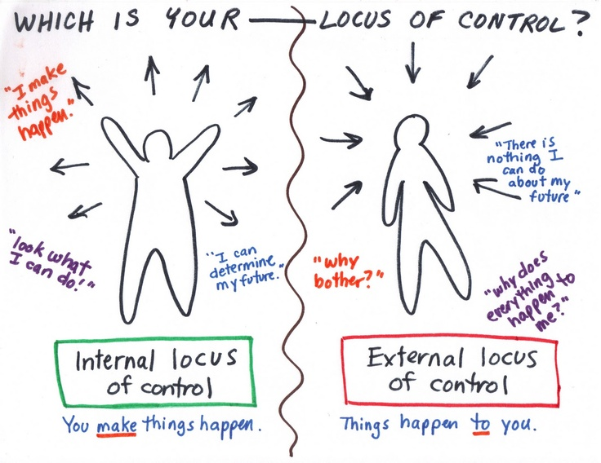

Slide 21
Janet Meikle
Money Advisor
Broadacres

Slide 22
Circle of Influence

Slide 23
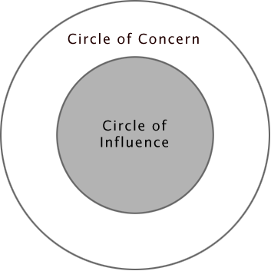
What is within my circle of influence?

Slide 24
Expanding your circle of influence Exercise – part 1
What are the challenges situations or people that face you at work?
From the things we have written down, select a problem or issue that is causing you concern/pressure and that you would like to influence. Chose one you are prepared to discuss with a partner and think about what you would like to change

Slide 25
Expanding your circle of influence Exercise – part 2
Discuss the issue you would like to address with a partner explaining what you would like to be different
Reflect on what can you do to move it into your area of influence (this may mean reframing the problem)
What strengths and resources have you got to solve the problem?
What is limiting / stopping you (focus on internal sources)?
Who do you need to influence or gain support from to achieve this?
(15 minutes each way)

Slide 26
BREAK

Slide 27
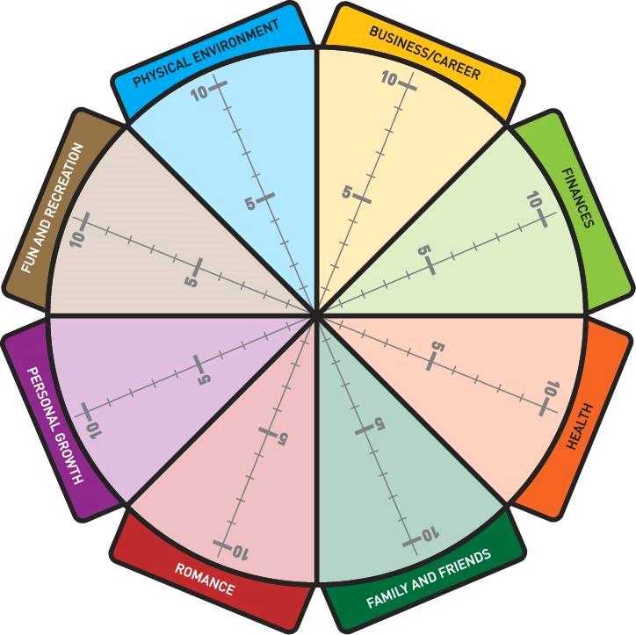
Work-life Balance
Individual Task
Complete the ‘wheel of life’ scoring yourself from 0-10 on how satisfied you are with that area of your life
0 = Poor
10 = It can’t get any better

Slide 28
Thank you
E: Camilla@housingdiversitynetwork.co.uk
T: 07791488196
W: housingdiversitynetwork.co.uk
Camilla Veale
Mentoring Co-ordinator
@HDN_UK

