Slide 1
HDN Staff Mentoring
North East and Yorks & Humbs
November 29th 2018
Camilla Veale
Mentoring Associate
@HDN_UK
Notes:
Introduce myself
Check all comfy, can see, hear, warm etc.
Mobiles – silent
Fire alarm
Smoking
Toilets
Mentee intro’s?

Slide 2
Introductions
Name
Job Title
Housing Organisation
Mentoring Sessions
What is the one goal you’d like to accomplish during your lifetime?
Notes:
ICE BREAKER
Ground rules – briefly discuss?
Recap programme objectives & class dates again & expectations
Taster sessions
Participate
Network/learn from each other – think of something to ask other orgs at break & lunch times especially mentors! – goals/roles/approaches/tv
Ask questions
Help each other
Have fun!
Be honest
Jelly bean exercise
Colour
Discuss
Feedback
INTRODUCE JK & What skills now and how to develop in the future?

Slide 3
What you will get from today:
Objectives:
Get to know other & start to build networks
Reflect on your goals/objectives for the programme
Discuss your skills & strengths
Consider how to develop yourself for the future
Activities:
Getting to know each other
Where are you & how do you develop/help yourself?
Introduction to Learning Styles
PPI (self-insight tool) & others tools for development
Reflection & update PDL
Notes:
What you will get out of today!
Last objective: Tools = Wheel of life, Belbin Team Roles, PPI, Circle of Influence, STAR

Slide 4
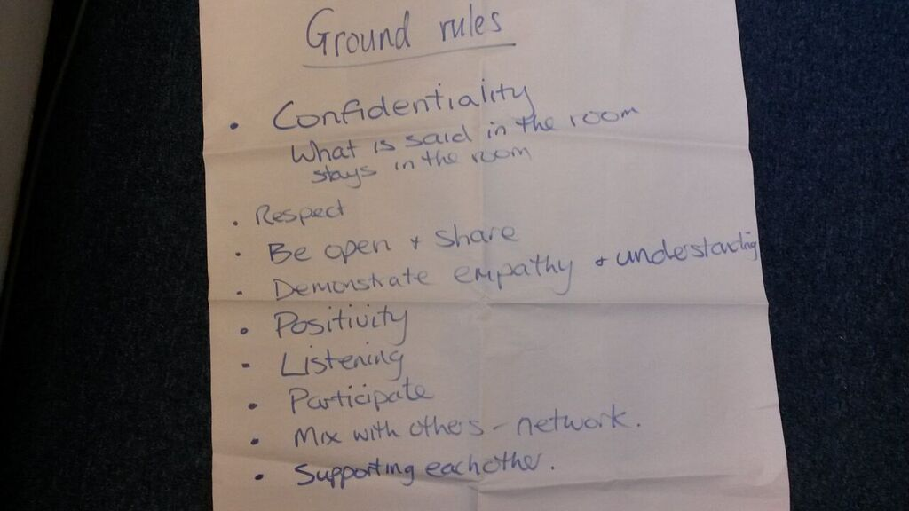
Welcome to Workshop 1 ‘Getting to know you’
How we will work today – roles & ground rules

Slide 5
Key dates
Class One “Getting to know you” | Thursday 29th Nov 2018 (10.00 – 4.30pm) Leeds Federated Housing Association Leeds
Class Two “Understand your environment” | Wednesday 9th Jan 2019 (10.00 -4.30pm) Broadacres Northallerton
Class Three “Challenges & opportunities” | Thursday 28th February 2019 (10.00 -4.30pm) Broadacres Northallerton
Class Four “Moving forward” | Wednesday 3rd April 2019 (10.00 -4.30pm) Karbon Newcastle Upon Tyne
National Conference: June 20th 2019, Birmingham
Notes:
Mentors welcome to attend any classes, even just for part of the day or just to network over lunch!
Some mentors facilitate or speak at classes.
Not designed to be training courses but to give a “bitesize” look at various topics with signposts to more information if they want to.
Go through topics that might be covered in classes.
Go through the topics highlighted in forms as popular.

Slide 6
Stephen Blundell
Operations Director
Leeds Federated Housing Association

Slide 7
Which jelly bean are you?
Now?
In 2 years?
Notes:
Get Mentees to colour in the Jelly Bean for where they are now and the Jelly Bean for where they want to be in 2
Years time.
Get a few of them to talk about their Jelly Beans
How the Programme can help them get to be the Jelly Bean they want to be

Slide 8
BREAK

Slide 9
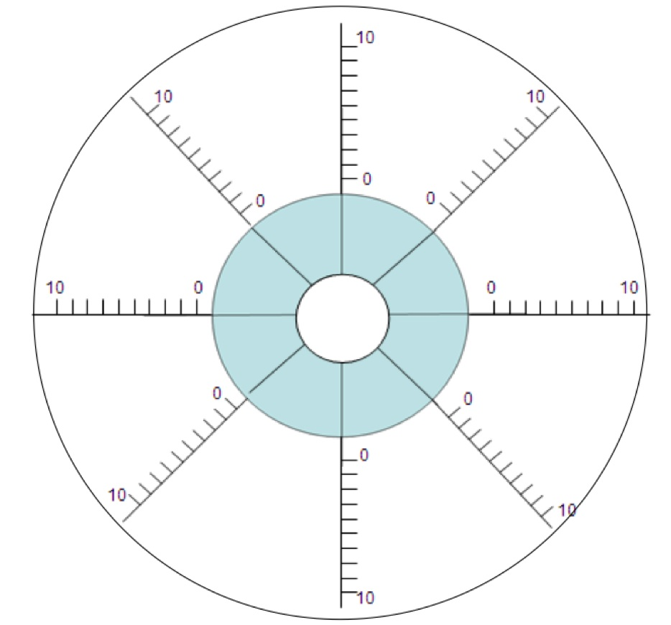
Where are you now?
Communication
Confidence
Planning
Work relationships
Priorities
Managers
Deadlines
Workload
Notes:
Get Mentees to complete the Work Wheel
0 = terrible 10= couldn’t be better
Get Mentees into pairs to coach each other about their two lowest scores – how to improve the score

Slide 10
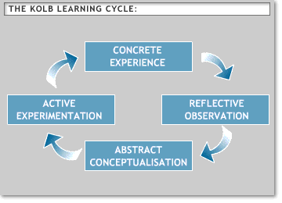
Kolb’s Learning Cycle
Notes:
Ask if any Mentee has come across the cycle before – if yes can they explain it ?
Explain Kolb’s learning cycle – Different stages
Effective learning – you go through the whole cycle.

Slide 11
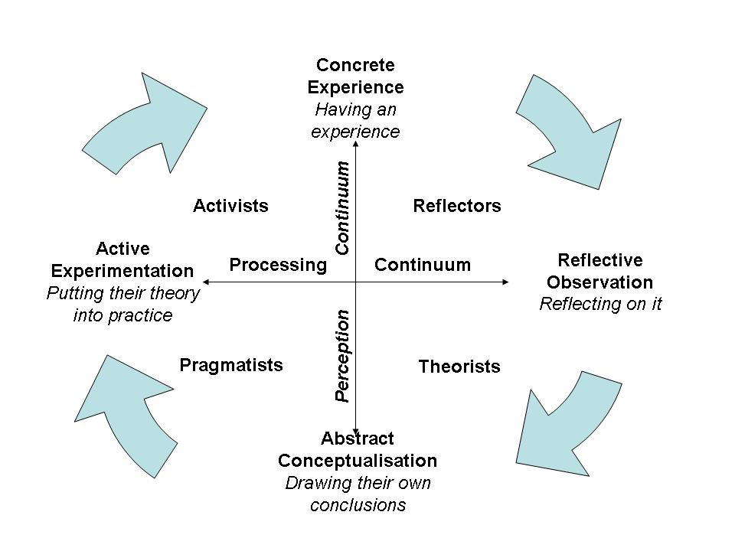
Learning Styles – Honey and Mumford
Notes:
Honey and Mumford took Kolbs cycle and identified that people have a natural preference for being
at a certain point in the learning cycle.
They identified four distinct learning styles Activists , Reflectors, Theorists and Pragmatists
Most of us tend to to follow only one or two of these styles.
Give out Learning styles questionnaires and get Mentees to complete them
Flip chart what learning style they are – initials on flipchart

Slide 12
Dianne Walker
HDN Mentee 2017/8
Leeds Federated Housing Association

Slide 13
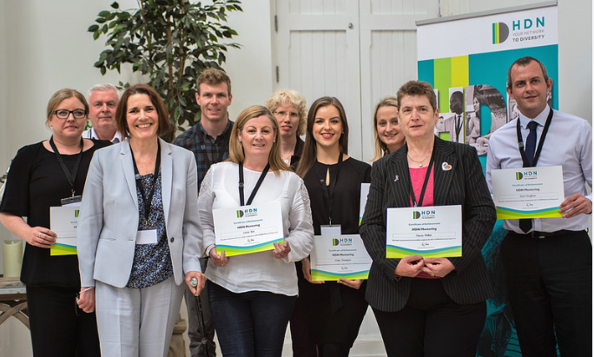
Getting the most out of the Mentoring Programme

Slide 14
Getting the most out of the Mentoring Programme
My Background
What I got out of the programme
How I changed as a result of completing it
Any job/work changes
Highlights for me
How my mentor helped me

Slide 15
Top tips for getting the most out of the programme
Attend all the sessions
Schedule all meetings with mentor in advance
Participate
Enjoy it
Network
Attend the national conference

Slide 16
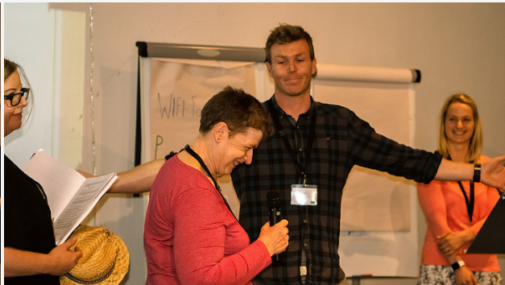
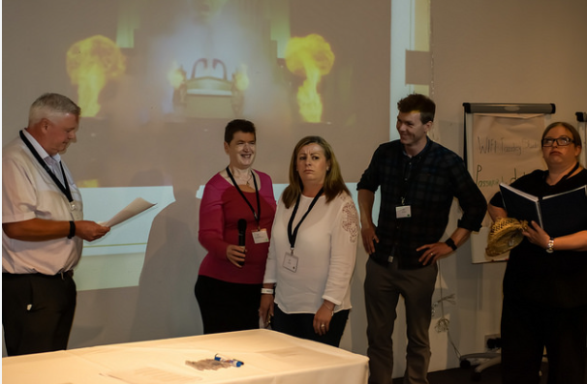
National Conference – The Mentor of Us!!

Slide 17
Thank you Any questions?
It’s Lunch Time!
Notes:
Network over Lunch !

Slide 18
Learning Styles
Questionnaire
What is your top learning style ?
What is your second favourite style ?
Variety in the group
How will you learn best on the Programme ?

Slide 19
PPI Tool
Dr Marston’s “Emotions of Normal People” 1928
Dominance
Influence over others
Steadiness
Compliance
Notes:
Explain the PPI tool
What Disc stand for
Mentees will be invited to complete PPI between workshop 1 and workshop 2
Mentors have already been invited to complete it.

Slide 20
PPI report: how people are likely to behave in work
Motivation
Strengths
Learning Style
Team member
Team leader
Stress etc etc
Notes:
WhaPPI is a work based personality profiling tool, developed from the original work of Dr. William Moulton Marston
All mentees and mentors given the opportunity to complete this
Aim is enable mentees to try out an example of a psychometric tool and to provide self insight which you can use for your own development during the programme
Report will be confidential to you and not shared with anyone in your organisation – but your mentor will expect you to share it with them so they can support you to use it most effectively
There is still a great deal we do not understand about personality i.e. nature vs nurture, the extent to which it is fixed etc.
Psychometric testing is based on a particular school of psychological thought known as ‘Trait Theory’ (Eysenck and Cattell). Critics of this theory suggest that traits are not always accurate predictors of behaviour
Personality profiling tools do not measure or predict skills and abilities
People can use their preferred and non preferred styles. Just because you may not naturally enjoy an aspect of work does not mean you cannot develop a high level of competency in it
There are no better or worse types to be
Situational and contextual factors such as how you are feeling about work today and external factors can affect how you complete the test and therefore result
Reports are generated by a computer and use standardised language
Indicators (not measure or judgement). Use for discussion not decision making
The results should only be used for personal reflection and growth – it is up to mentee to decide how meaningful/useful they are
t is contained within the PPI report

Slide 21
You are the mentor and your mentee has shared their report with you…
What questions would you ask them to help them explore the PPI?
Are there any strengths? Are there any development areas?
What development actions might this mentee take?
How do you think the PPI helps increase our self-awareness?
Notes:
Divide Mentees into 6 groups of 5 (or similar)
Hand out the blanked out PPI profiles to groups
In groups read the profile and then answer these questions
Get groups to feedback on one of the questions – other groups chip in afterwards
What did you think about the language ?

Slide 22
PPI (Personality Performance Indicator)
The questionnaire:
Online/24 questions/5-7 minutes to complete
Answer quickly and spontaneously
There are no right and wrong answers
Be true to yourself
The report:
Approx. 10 pages long
Understanding and using the results:
Class 2 will provide opportunity to share parts & ask questions
Share with your mentor & discuss at your future mentoring sessions
Other support available
Notes:
What is involved with the PPI ?

Slide 23
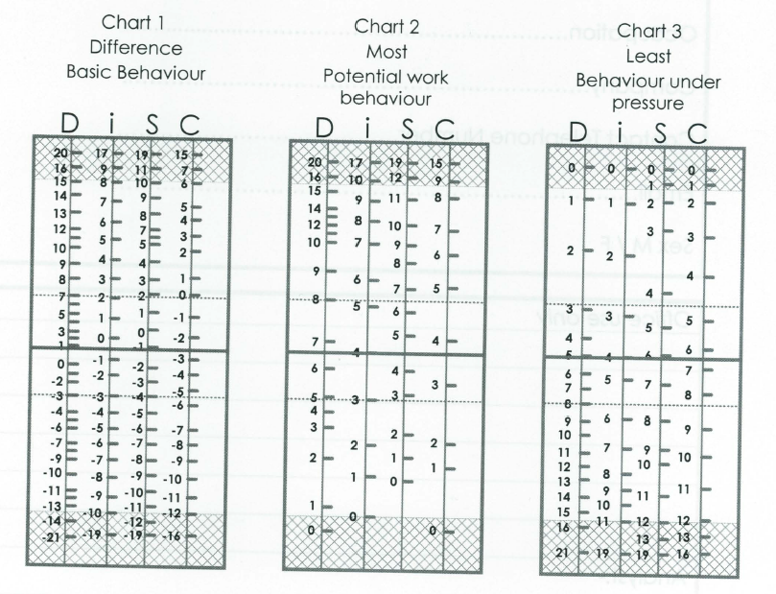
DISC – Personality Profile
Review the three Charts/Graphs:
Basic Behaviour (Self-image)
Potential Work Behaviour (Work mask)
Behaviour under extreme pressure (Pressure Profile)
Notes:
You will get a graph as well at workshop 2 – use them for discussions
Benefits of PPI – Paul Noddings – Policy Manager, Thirteen
How he has used it
Other psychometric profiles he has completed – use as a manager.

Slide 24
Covey’s 7 Habits
Notes:
Go through the 7 habits

Slide 25
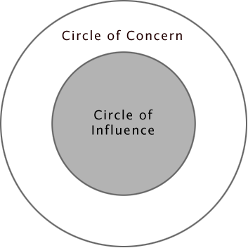
What is within my Circle of Influence?
Notes:
Give out handouts

Slide 26
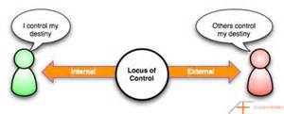
Locus of control
“The degree to which individuals either perceive that outcomes result from their own behaviours, or from forces that are external to themselves”
Notes:
Explain locus of control
Cut this bit if time running out and skip to CIRCLE of Influence.
Come back to this in class 3 – building resilience

Slide 27
How do I manage myself?
LOCUS OF CONTROL
External Locus Internal Locus
of control of control
Take little or no responsibility for their behaviour
Blame others for what is wrong in their life
Tend not to do things that will change their life for the better
Emphasis is to avoid coming out of their personal comfort zones
When things go wrong they often do not learn from their mistakes
Tend to rely on other people’s approval to make them feel good
Have weak boundaries and strong barriers
Lack the ability to be able to inner reflect
Take responsibility for their actions
Do things that will change their situation for the better
Emphasis is on striving for personal and professional achievement
Work hard to develop their knowledge, skills and abilities
When things go wrong they are inquisitive and try to work out why things turned out the way they did
Tend not to blame others
Have a more participative management style
Tend not to rely on other peoples evaluation for their self-esteem
Strong boundaries and weak barriers in most areas
Have the ability to inner reflect
www.mindtools.com

Slide 28
STARR
Situation
Task
Action
Result
Reflection
Notes:
Go through STARR
Look at in workshop 3 & 4

Slide 29
Review for the day
Any questions?
Did you get what you expected from today?
How will you use today’s experience at work?
How can your mentor help you? Plan your next mentoring session
Complete your PDL
Prepare for Class 2
Feedback form

Slide 30
Evaluation
Todays sessions
Reflect on current skills
Learning Style
PPI
Making the most of yourself
Notes:
Explain evaluation
Rate todays sessions

Slide 31
Thank you
Camilla Veale
Mentoring Associate
@HDN_UK
Tel 07791488196
Email: camilla@housingdiversitynetwork.co.uk

