Slide 1
HDN Mentoring Programme
Class Three
Challenges and Opportunities
Sue Waterall

Slide 2
Groundrules
This is really the time to:
Lean in ... reach out … embrace ….
Keep asking questions
Engage with guest speakers
Be open to learning
And have fun!

Slide 3
Agenda
Mentoring experiences
A career in housing – Ulfat Hussain
Individual presentations – yay!
National Conference 2019
Teamworking & Managing Change – Chris Twomey
Management & Leadership – Chris Twomey
Moving forward and networking

Slide 4
Mentoring experiences
Progress of 1:1s – regularity, quality, thoughts
Success stories – from tiny to big
Things you have learnt about yourself, the housing sector, others, the future, life!

Slide 5
Please welcome:
Ulfat Hussain
Director of Operations

Slide 6
Individual Presentations
Annette Morrison
Bev Turner
Helen Curtin
Sarah Thornley
Anne Bond

Slide 7
Presentations: Delivering or observing, what did we learn?

Slide 8
When we present …
“The human brain starts working the moment you are born and never stops until you stand up to speak in public”
Sir George Jessel

Slide 9
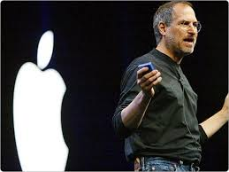
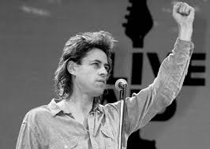
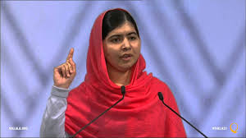
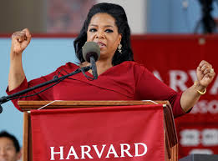
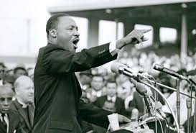
What makes an effective presenter?
Notes:
Steve Jobs – was CEO, co-founder of Apple
Malala Yousafzai - shot by the Taliban in 2012
Bob Geldof – imploring us all at Live Aid in 1985 to give him ourmoney
Oprah Winfrey – speaks out on domestic abuse and breaking down racial barriers
Martin Luther King – powerful civil rights activist
Jeremy Corbyn – Glastonbury

Slide 10
Getting the balance right
Head – logic, rationale, facts, figures, graphs, process
Heart – passion, engagement, authenticity, story telling, emotion

Slide 11
Preparation
Why – the overall purpose
What – specific objectives
Who – the audience
When – time of day
Where – environment and venue
How – structure and content
Notes:
Who – the audience. Consider 3 things:
What do they already know?
What misconceptions about or barriers to your subject might they have?
What compelling message will you give them?
Feature and benefits
People are less convinced by:
Features – description, characteristics
Than
Benefits – here’s what you personally will get out of it. Here’s what it can do for you? Here’s how it will improve an aspect of your working life.

Slide 12
Tonight’s
stories in more
detail …
The headlines
tonight …
And the headlines again…
Main body
Introduction
Summary
Notes:
Main body
Rule of 3, grounded in cognitive psychology:
3 parts/sections
3 key points
3 messages

Slide 13
BANG!
Creating those sit up and listen, jaw-dropping, did-you-get-that moments.
Notes:
“

Slide 14
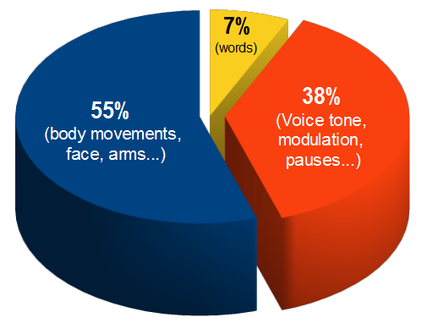
Communication – Words, Tone, Body

Slide 15
Why are TED talks successful?
The first 30 seconds create impact
They connect with people emotionally
Scripts kill charisma
65% stories, 25% data, 10% presenter
Smile, gesticulation and movement

Slide 16
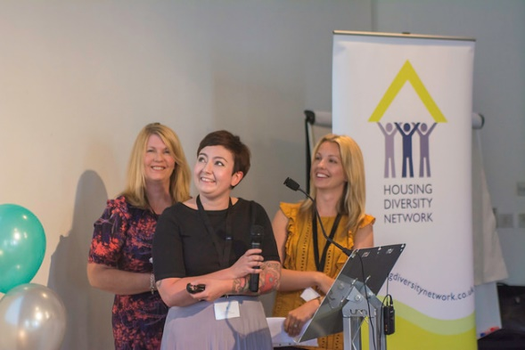
National Conference 2019
Thurs 20th June – Think Tank Birmingham
Let’s put the north on the map …..volunteers?!

Slide 17
T.E.A.R. Model
Thoughts
Results
Emotions
Actions

Slide 18
Presenting at the conference
“We were all given the opportunity to present at the conference.
I was SO glad I took part! It was a great opportunity and it’s not the sort of opportunity you often get!
Several of the group said afterwards that they really wished they had done it too.
To me, it felt like it was the whole point of the course”.
Donna Stringer, Riverside
“My advice for the national conference is to just go for it! Put yourself out there and volunteer to present!
Everyone at the conference is willing everyone else to do well. It’s such a supportive atmosphere and there was great buzz in the room on the day.
To be able to say you have presented to 200 people at a national conference is a big confidence boost personally - but also an added bonus for future job interviews”.
Sophie Heneghan, Riverside
Notes:
2017 Conference Presenters (with Vicki Maguire)

Slide 19
Please welcome:
Chris Twomey
Deputy Director of Housing & Inclusion
West Lancs Borough Council

Slide 20
Moving forward and networking

Slide 21
What is networking?
Friendly, mutually supportive relationships
Helping a colleague learn
Sharing experiences and opportunities
Enriching one another’s lives
It’s a conversation not a sales pitch
You don’t have to be an extravert
Listen, talk, listen, LinkIn, ask, tell, chat …

Slide 22
Everyone in this room is valuable!
All these colleagues could help you with:
Where you might want to work in the future
Understanding a different kind of job
A new qualification or training course
Introductions to someone else
Finding new opportunities
A short job shadow
Being a buddy
A site visit to somewhere new
A neighbourhood project

Slide 23
Social Media
Notes:
Clockwise: Snapchat, Reddit, Facebook, WhatsApp, Instagram, Twitter, Pinterest, Skype, LinkedIn

Slide 24
Ask yourself
Apart from your work colleagues:
Who else do you know in this room?
By name?
By organisation?
By job role?
By a passion or interest they have?
By a project they’ve worked on?

Slide 25
Class 4 and
National Conference
Class 4
Date: Fri 24th May 2019
Time: 09.45 - 3.45
Venue: Great Places – 2a Derwent Avenue, Manchester M21 7QP
National Mentoring Conference
Date: Thurs 20th June 2019
Venue: Think Tank, Science Museum,
Millennium Point Birmingham B4 7XG.

