Slide 1
Board responsibilities for assurance and risk management
Karen Doran
Assistant Director Regulatory Operations

Slide 2
Agenda
Session 1
Risk management, controls assurance and stress testing
The role of the Audit Committee
Session 2
Value for money (VfM)

Slide 3
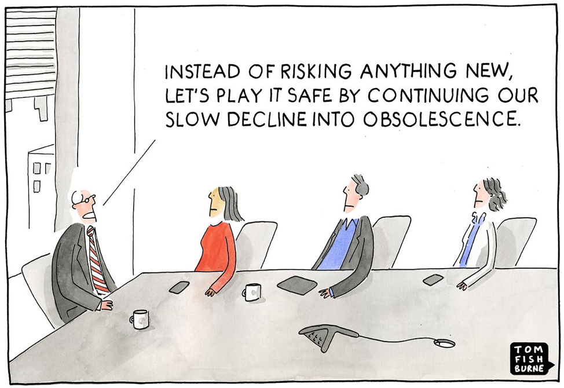
Risk management – expectations and focus
Strategic delivery and risk
Operating environment
Role of the board
Governance
Value for Money

Slide 4
Risk management framework
Strategy
Risk appetite
Risk identification
Risk assessment
Risk controls
Controls assurance
Risk and strategic delivery assurance

Slide 5
Delivery of strategic objectives
Strategy =
what the board wants to achieve
Objective=
Measurable outcome to deliver this
Risk =
what might stop it
Controls =
what mitigates the risk
Assurance =
knowing it is all working
Growing to meet the needs of a wide range of future tenants
Develop XX number of new affordable homes by XXXX
Schemes overrun significantly on costs leading to impairment
Management information and reporting to development committee
Finance Director challenge, Internal audit, specialist review, external audit

Slide 6
Regulatory expectations
Registered providers shall ensure effective governance arrangements that deliver their aims, objectives and intended outcomes for tenants and potential tenants in an effective, transparent and accountable manner
Governance arrangements shall ensure registered providers … have an effective risk management and internal controls assurance framework
Registered providers shall ensure that they have an appropriate, robust and prudent business planning, risk and control framework

Slide 7
Governance and Financial Viability (G&FV) Code of Practice
21 Registered providers need to ensure their business planning, risk management and control framework is effective. It should cover all areas of the registered provider’s business. This should demonstrate the registered provider fully understands and has considered its operating environment, so it can deliver its business plan and organisational objectives. It does not need to be captured in a single document.
29 Boards are the custodians of social housing assets and the financial viability of the registered providers that hold those assets. The responsibility for managing risks, and specifically risks to social housing assets, lies with boards.
35 The regulator expects registered providers, as part of their risk management approach, to stress test their plans against different scenarios across the whole group.
39 As long-term businesses, registered providers need to ensure … that short term decisions do not constrain their ability to cope with risk. This does not prevent registered providers from taking on measured risk to deliver their objectives. It means that when taking on risks, boards should fully understand the impact on their business in the round, as well as on their social housing assets. Boards should have appropriate mitigations and controls in place as well as a strategy to protect those assets during the long term.

Slide 8
NHF Code of Governance 2020
Key part of one of the four principles underpinning the Code:
The board actively manages the risks faced by the organisation and obtains robust assurance that controls are effective, that plans and compliance obligations are being delivered, and that the organisation is financially viable
4.1 Audit:
the board has formal and transparent arrangements ensuring that the organisation is financially viable and maintains both a sound system of internal audit and controls and an appropriate relationship with its external auditors’
The board can have confidence in the information it receives and there are robust internal controls
There is a committee primarily responsible for audit, and there are arrangements for effective internal control assurance and audit functions - external audit
4.2 Audit committee:
a committee that exercises independent scrutiny and challenge to provide the board with assurance

Slide 9
UK Corporate Governance Code
Explicit links between corporate governance and effective risk management processes.
The board should establish procedures to manage risk, oversee the internal control framework and determine the nature and extent of the principal risks the company is willing to take in order to achieve its long-term strategic objectives.
Prescriptive and comprehensive on the role of the Audit Committee

Slide 10
Role and duties of board members
Legal structure and charitable status
General / common law duty of trust
Charitable status – significant responsibilities and legal duties
Stewards and custodians
Company law and director duties

Slide 11
How do we assess effectiveness of risk management and internal controls assurance
Extent to which viability risks can and are managed / mitigated
Taking a whole view – bringing governance and viability together
How key risks are managed in practice – the effectiveness of board oversight
Not assessing the quality of documents but operation of framework
Reactive - risks crystalised, material internal control(s) failed or is not in place, preventative - gap in board’s assurance
Delivery of strategic objectives

Slide 12
Assessing how key risks are managed in practice
In all cases consider
materiality
Controls and oversight
performance
assurance arrangements
outcomes.
Examples
Health & safety compliance
Development
Stress testing and mitigation strategies

Slide 13
Example of evidence on management of H&S risks taken from Evidencing Assurance slides
Knowledge of stock – components and condition (G&V)
The risk assessment, (coverage of H&S risks) documented controls (G)
Board’s assurance – management reporting, third-party assurance – internal audit, specialist advice, CQC inspection outputs… (G)
Clarity of responsibility in structures (G)
Discussion with members re understanding of risks and key controls, and its assurance that the risk is well managed (G)
Board capacity to manage H&S risks - oversight of performance from board or committee (G)
Adequacy of financial forecasts for stock investment versus need identified in SCS. (V)
Stress testing outputs demonstrate capacity to do more (V)
All together this adds up to our assurance on the
management of that risk then contributes to management of risk in general.

Slide 14
Regulating risk management
Risk is being managed via proper systems and controls and not by chance
Documentation - essential to effective risk management
Risk map/assessment:
Risk identification – identify risks accurately
Risk assessment – inherent risk
Controls – weight of controls
Risk assessment - residual risk
Owners
Further actions
Assurance

Slide 15
Risk management framework
Strategy
Risk appetite
Risk identification
Risk assessment
Risk controls
Controls assurance
Risk and strategic delivery assurance

Slide 16
Risk management framework – key elements
Risk appetite
“The level of risk that is acceptable to the Board or management”. (IIA)
“RPs should have a clear understanding of their risk tolerances and ensure that they are appropriate to the scale and nature of the activities they are undertaking”. (RSH code of practice)
Appetite is a driver of golden rules – internal tolerances within which an organisation decides to operate. Usually within bank covenant limits.
Appetite should be regularly reviewed by Boards. Sometimes a good idea to include within externally facilitated risk workshops.

Slide 17
Identifying risks …
Objective – to travel by train from A to B for a meeting at a certain time
Risk??
Failure to get from A to B on time for the meeting | This is simply the converse of the objective
Being late and missing the meeting | This is a statement of the impact of the risk, not the risk itself
There is no buffet on the train so I get hungry | This does not impact on achievement of the objective
Missing the train causes me to be late and miss the meeting | This is a risk which can be controlled by making sure I allow plenty of time to get to the station
Severe weather prevents the train from running and me from getting to the meeting | This is a risk which I cannot control, but against which I can make a contingency plan

Slide 18
Assurance
Confidence / sureness that strategy is being delivered and that risks are being managed within appetite.
Needed on – risks, data, controls, procedures, strategic and operational performance,
Have a plan to achieve it – map the sources of assurance the board gets against key risks
Management reports / KPIs
Internal audits and ccompliance reviews
Specialist advice (legal, treasury, H&S)
Inspection outputs (e.g. CQC, regulatory judgements)
Stress testing outputs and recovery planning
Rightsizing Assurance
Scope, depth, desk-top, inspection, independent, management
Basis in data – if data is wrong then assurances will be meaningless

Slide 19
Stress testing and recovery planning
RSH context:
Stress testing - Analysis of the impact of risks, or combinations of risks, on business plans to determine the extent of the economic shocks and/or internal failure the plan can cope with.
Recovery planning – Devising deliverable plans which could be enacted to manage those stress scenarios and allow the business to remain financially viable.

Slide 20
Stress testing and mitigation planning – specific expectations
Registered providers shall assess, manage and where appropriate address risks to ensure the long term viability of the registered provider, including ensuring that social housing assets are protected. Registered providers shall do so by … carrying out detailed and robust stress testing against identified risks and combinations of risks across a range of scenarios and putting appropriate mitigation strategies in place as a result
… maintaining a thorough, accurate and up to date record of their assets and liabilities and particularly those liabilities that may have recourse to social housing assets

Slide 21
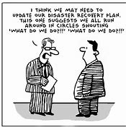
Stress testing links with business planning and risk management
Information to base decisions on how resources are deployed to deliver strategy
Informs the materiality of financial risks
Aids understanding of cumulative impact of risks
Quantifies and checks application of stated risk appetite
Identifies / tests key preventative and detective controls
Highlights vulnerabilities
Allows orgs to set early warning indicators/triggers for action and golden rules
Plans in place to ensure org is well ahead with quantified, realistic and actionable mitigations should the worst happen

Slide 22
Stress testing links with business planning and risk management
Produces information from which to base decisions about how resources are deployed to deliver strategy
Informs the materiality of financial risks
Highlights vulnerabilities and allows orgs to set early warning indicators/triggers for action and golden rules
Plans in place to ensure org is well ahead with quantified, realistic and actionable mitigations should the worst happen

Slide 23
Stress testing and mitigation planning
Stress testing should be an integral part of business planning and risk management
Stress tests are taxing and consider:
internal and external factors, separately and in combination
cross group impacts and risks
comprehensive asset and liability records information
impacts against cash, security and covenants
Boards are fully involved in stress testing and recovery planning and that reporting is clear and comprehensive
Recovery / mitigation plans to address scenarios are well developed
Testing is used to inform risk management, business planning, risk appetite and decision making

Slide 24
Take aways - session 1
Use stress testing to show how risks might impact on the business and therefore inform controls
Identify and quantify the risks to achieving those objectives
Be clear about your org’s purpose and objectives
Be able to evidence good levels of assurance on the design and operation of key internal controls
Have processes in place to review risk management and assurance arrangements over time
Link assurance to risks and be sure you’re getting enough assurance that risks are being managed
Have a fresh look at board reporting and be satisfied that quality, coverage and frequency is assisting in managing risks
Ask yourselves how you know that risk controls are operating as intended
Have a well articulated assessment of strategic risks and associated controls

Slide 26
Role of the Audit (and Risk) Committee
Significant role in audit and has taken on more on risk:-
Oversees external audit and the certification of the accuracy of the financial statements.
Gains assurance that risks, and changes in risk, are being assessed and that appropriate controls to manage risks are in place
Receives and assesses assurances on how well controls are operating and that risks are being managed
Delivers an overall opinion about risk management and internal controls assurance
Assesses and make recommendations to improve the appropriateness of the risk management and assurance processes
The Audit Committee should not itself own or manage risks and is, as with internal audit, not a substitute for the proper role of management in managing risk.
Key role in enabling board in its responsibilities but not instead of

Slide 27
NHF code of governance 2020 – Control and assurance (Principle 4)
‘4.1 Audit: the board has formal and transparent arrangements ensuring that the organisation is financially viable and maintains both a sound system of internal audit and controls and an appropriate relationship with its external auditors’
The board can have confidence in the information it receives and there are robust internal controls
There is a committee primarily responsible for audit, and there are arrangements for effective internal control assurance and audit functions - external audit
‘4.2 Audit committee: a committee exercises independent scrutiny and challenge to provide the board with assurance’

Slide 28
Value for Money

Slide 29
VFM – Required Outcomes
“ Registered providers must:
clearly articulate their strategic objectives
have an approach agreed by their board to achieving value for money in meeting these objectives and demonstrate their delivery of value for money to stakeholders
through their strategic objectives, articulate their strategy for delivering homes that meet a range of needs
ensure that optimal benefit is derived from resources and assets and optimise economy, efficiency and effectiveness in the delivery of their strategic objectives. “

Slide 30
VfM Expectations
Registered providers must demonstrate a robust approach to how they decide to use their finances to delivery strategic objectives, considering:
Risk appetite, modelling of what can be delivered within it
costs and benefits of alternative delivery structures
VfM across the whole business
Investment in non-social housing activity is contributing to strategic delivery and generating returns commensurate to the risk involved
Reporting against RSH and RP’s own strategic VfM targets including public reporting that enables stakeholders to understand:
comparison on VfM and costs with peers
what’s been delivered and measurable plans to address any areas of underperformance

Slide 31
RSH VfM Metrics + Provider specific targets
Core Metric | Description
Reinvestment % | Scale of investment in development and capital expenditure on current assets
New supply delivered (SHL and non SHL) % | Units acquired or developed in the year
Gearing % | Proportion of borrowing in relation to size of asset base
Earnings Before Interest, Tax, Depreciation, Amortisation, Major Repairs Included (EBITDA MRI) Interest Cover % | Key indicator for liquidity and investment capacity
Headline social housing cost / unit | Overall SHL costs and main sub-costs per unit
Operating margin (SHL and overall “Group”) % | Operating Surplus, (deficit) / Turnover
Return on capital employed – ROCE % | Surplus / Deficit PLUS disposal of fixed assets PLUS profit / loss JVs compared to total assets
Provider specific measures/targets | Relevant to organisation specific aims/strategy

Slide 32
The strategic context of VfM
Boards increasingly face challenges making decisions regarding their use of assets and resources, including:
Increasing property compliance standards and requirements – building safety, health and safety, energy efficiency, DHS+…
Sustaining quality and value of existing stock – customer satisfaction
Growth – acquiring / building new homes – new customers
Regeneration, community initiatives, staff …

Slide 33
VfM board assurance – some suggestions …
Be clear on risk appetite and test the business plan to know what can be delivered whilst maintaining viability
Sound targets which will demonstrate delivery of strategic objectives
Regular reports on delivery of strategic objectives against agreed budgets and outcomes
Reports on investments
Reports on costs vs peers – maybe externally done
Explanations of high costs / under performance / reporting on plans for approval
Options for alternative delivery models for the whole business or elements of it
Annual accounts statement and other public VfM statements

Slide 34
Take aways – session 2
Strategic objectives – measurable targets, reporting and performance
Effective leadership - drive strategic delivery
Understand business stream and subsidiary performance
Understand costs and how they compare to peers.
Know that the allocated resources are delivering what was intended
Transparency / accountability to board and stakeholders
Where costs are increasing or high - understand why
Make VfM a meaningful part of decision making - especially investment decisions
Challenge VfM performance at strategic and operational levels

