Slide 1
Board Accelerator Programme 12 February 2026 Regulatory expectations on financial viability
Mick Warner
HDN Associate

Slide 2
Required outcome
Governance and Financial Viability Standard, Regulator of Social Housing (March 2015)
Registered providers shall manage their resources effectively to ensure their viability is maintained while ensuring that social housing assets are not put at undue risk

Slide 3
Specific expectations (1)
Registered providers shall ensure that they have an appropriate, robust and prudent business planning, risk and control framework

Slide 4
Specific expectations (2)
The framework shall ensure:
there is access to sufficient liquidity at all times
financial forecasts are based on appropriate and reasonable assumptions
effective systems are in place to monitor and accurately report delivery of the registered provider’s plans
the financial and other implications of risks to the delivery of plans are considered and
registered providers monitor, report on and comply with their funders’ covenants
(c)
(d)

Slide 5
Specific expectations (3)
Registered providers shall assess, manage and where appropriate address risks to ensure the long term viability of the registered provider, including ensuring that social housing assets are protected. Registered providers shall do so by … carrying out detailed and robust stress testing against identified risks and combinations of risks across a range of scenarios and putting appropriate mitigation strategies in place as a result

Slide 6
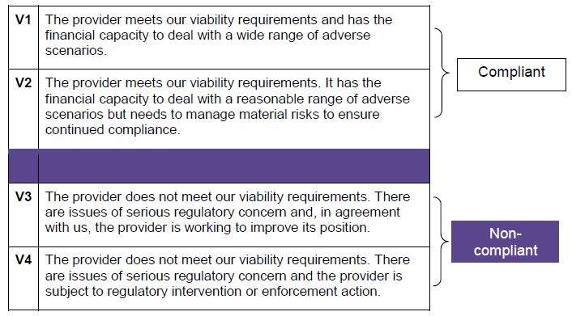
Viability grades

Slide 7
Governance and Viability Judgements
Grade | V1 | V2 | V3 | V4 | Total
G1 | 62 | 96 |  |  | 158
G2 | 3 | 23 |  |  | 26
G3 | 1 | 5 | 6 |  | 12
G4 |  |  | 1 | 1 | 2
Total | 66 | 124 | 7 | 1 | 198
Notes:
Numbers go up and down due in the main to mergers and providers going over the 1,000 home threshold
There are never any providers in the top right hand corner
At 31 October 2022, 202 judgements, 137 V1, 60 V2, 5 V3 – inflation, interest rates, spend required on H&S, quality and decarbonisation

Slide 8
V2 is the new normal for “now”
“For the moment, V2 is going to be the new normal. There will be some providers that move up and some that move down, but in broad terms for the foreseeable future, I think the sector is going to be predominantly a V2 sector. V2 is a reflection of the economic reality that the sector’s in at the moment. I don’t think there’ll be negative consequences for those providers if they are regraded this year. But what’s important is that you understand the risks and you’ve got plans to mitigate them. V2 is fine, but V3 is very definitely not”
Jonathan Walters, Deputy Chief Executive, Regulator of Social Housing, article in Inside Housing, 28 November 2023

Slide 9
Financial opportunities and risks
“The measures implemented in the Spending Review and reflected in the forthcoming Budget Statement, are intended to enable long-term investment in the sector and give PRPs greater certainty in the regulatory environment, enabling them to better manage their finances and increase ambitions on new supply… Further challenges and opportunities will arise as additional details of the DHS, MEES (Minimum Energy Efficiency Standard), rent convergence and Awaab’s Law emerge. PRPs should ensure that plans are adapted to reflect emerging opportunities and new requirements. It is vital they understand and manage any additional risks, identify potential liquidity and covenant restrictions, and maintain robust contingency plans”
Quarterly Survey July to September 2025, Regulator of Social Housing, November 2025

Slide 10
Thoughts? Questions? Comments?

Slide 11
www.housingdiversitynetwork.co.uk
mick@housingdiversitynetwork.co.uk

