Slide 1
The role and regulatory approach of RSH
Expectations of boards
Themes and lessons learnt
David McCormick
Senior Financial Analysis Manager
Karen Doran
Director of Regulatory Engagement

Slide 2

The role of the Regulator
    Why it exists
      Maintain lender confidence (cost of funding)
      Protecting the taxpayer
      Protecting tenants – expanding consumer role
    Ensure that registered providers of social housing are financially viable and properly managed and perform their functions efficiently and economically
    Done via outcome-based standards - Regulating the Standards

Slide 3

How we regulate

Slide 4

The Standards
    Economic
    Governance and Financial Viability
    Value for Money
    Rent
    Consumer
    Transparency, Influence and Accountability
    Safety and Quality
    Tenancy
    Neighbourhood and Community

Slide 5
Examples of required outcomes from the standards
Registered providers shall ensure effective governance arrangements that deliver their aims, objectives and intended outcomes for tenants and potential tenants in an effective, transparent and accountable manner.
Governance arrangements shall ensure registered providers … protect social housing assets.
Registered providers shall meet all legal requirements that relate to the health and safety of tenants …
Registered providers shall ensure that they have an appropriate, robust and prudent business planning, risk and control framework

Slide 6
Regulating different providers
Different approach for providers which own fewer than 1,000 social housing units
If under 1,000 units:
Economic and Consumer Standards still applicable, but
Limited data requirements applicable
Not required to complete Quarterly Survey, or subject to Stability Checks, Inspections or Regulatory Judgements.
Subject to annual review of financial statements and, if relevant, the audit management letter.
Full summary of our approach can be found in Regulating the Standards

Slide 7
Accurate and timely data – data returns
Regulatory returns
Statistical Data Return (SDR) | Submitted by May each year
Financial Forecast Return (FFR) (plus business plan & supporting documentation) | Submitted by June each year
Quarterly Survey (QS) | Submitted 3 weeks after each quarter end
Electronic Annual Accounts (FVA) | Submitted 6 months after financial year end
Tenant Satisfaction Measures | Submitted between 1 April and 30 June – 2024 was the first year
Fire Safety Remediation Survey | Submitted 3 weeks after each quarter end
Supporting documents
Audited Accounts Audit Management Letter Fraud Report | 6 months after financial year end
Quarterly disposal notification Priority disposal notification | 3 weeks after each quarter end As required (guidance document available)

Slide 8

Regulatory framework
QC and QA of decision-making
Tenant insight
Inspections
Assess how well a landlord delivers outcomes in standards
Judgement and grading
Referrals / regulatory intelligence
Responsive engagement
Landlord improvement
Analysis of data submissions & TSMs
Investigation, enforcement and other tools
Review, lessons learnt, continuous improvement

Slide 9
Regulatory inspections
Strategy | Activities, priorities, markets
Structure and organisational dynamics Service outcomes Risk management Transparency, Influence and Accountability | Relationships between group entities Legal status, funding mechanisms and associated risks Collection and use of stock condition data Health and Safety compliance Repairs, ASB and domestic abuse Fair allocation of homes Key and emerging risks across the whole business Use of stress testing and recovery planning to identify and manage risk Fair and respectful treatment of tenants Use of tenant information Tenant engagement Complaints
Financial resilience | Financial performance Debt, liquidity and future funding Cost structure and efficiency
Governance | Quality of business planning and reporting Compliance and control VfM

Slide 10
Regulatory inspections
Scoping
Desktop review
Onsite work inc. tenant engagement
Review of assurance and gaps
Conclusions and outcomes
Notes:
Inspection
Planned or reactive
Set out in inspection plan – to be published on 29 Feb
Governance, viability and consumer for PRPs, consumer only for LAs
Scoping
Bespoke and tailored
Takes account of intelligence we have on RP
Desktop review
Review of evidence provider gives us
Understand level of assurance
Onsite work inc. tenant engagement
Meetings with key officers and board members/councillors
Meeting observations – boards, committees, scrutiny groups
Meeting with tenants, and other bespoke tenant engagement work
Review of assurance and gaps
Identify gaps in assurance, discuss with provider, and opportunity for more evidence to be submitted by provider.
Conclusions and outcomes
Judgement and gradings – G, V and C – including stocktake
Feedback to provider
Publication of judgement

Slide 11
Practicalities of Inspections
    Clear focus on material risks – largely assessing governance through management of risks
    Key documents:
      Business / financial plans including stress testing and recovery planning
      Board and committee papers including KPI reporting
      Risk assessment
      Management accounts
      Internal audit plans and outcomes
    Meetings – not pre-set / various combinations including meeting with tenants involved in scrutiny
    Co-regulatory – ask for more docs / assurance gap meeting

Slide 12
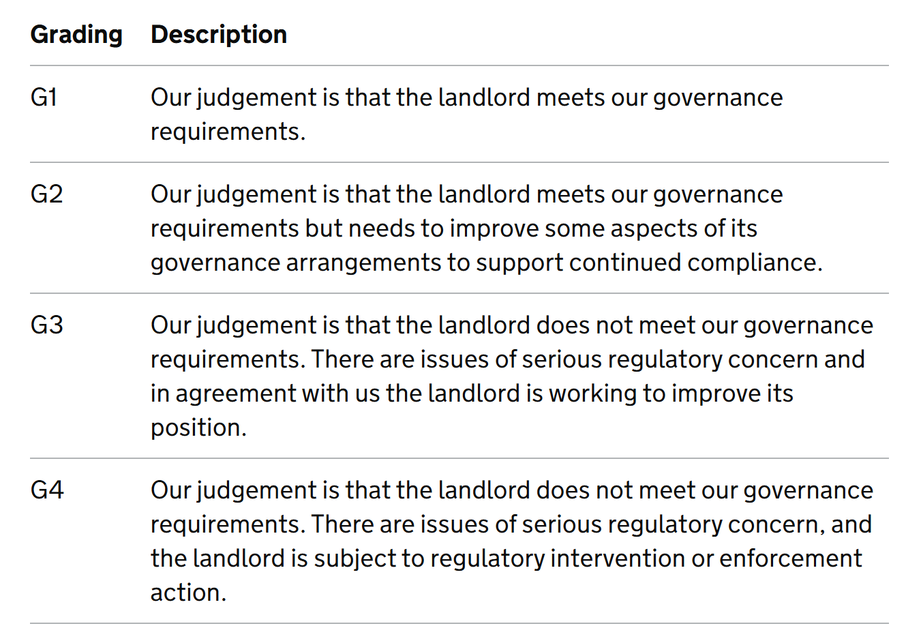
Regulatory judgements and gradings

Slide 13
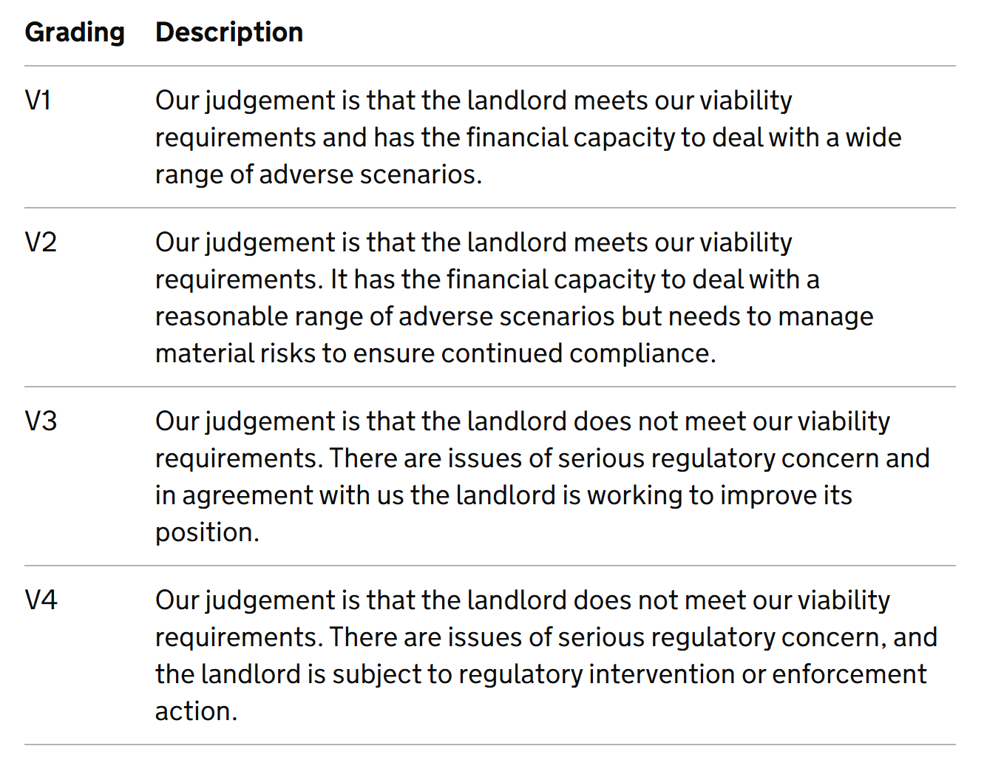
Regulatory judgements and gradings

Slide 14
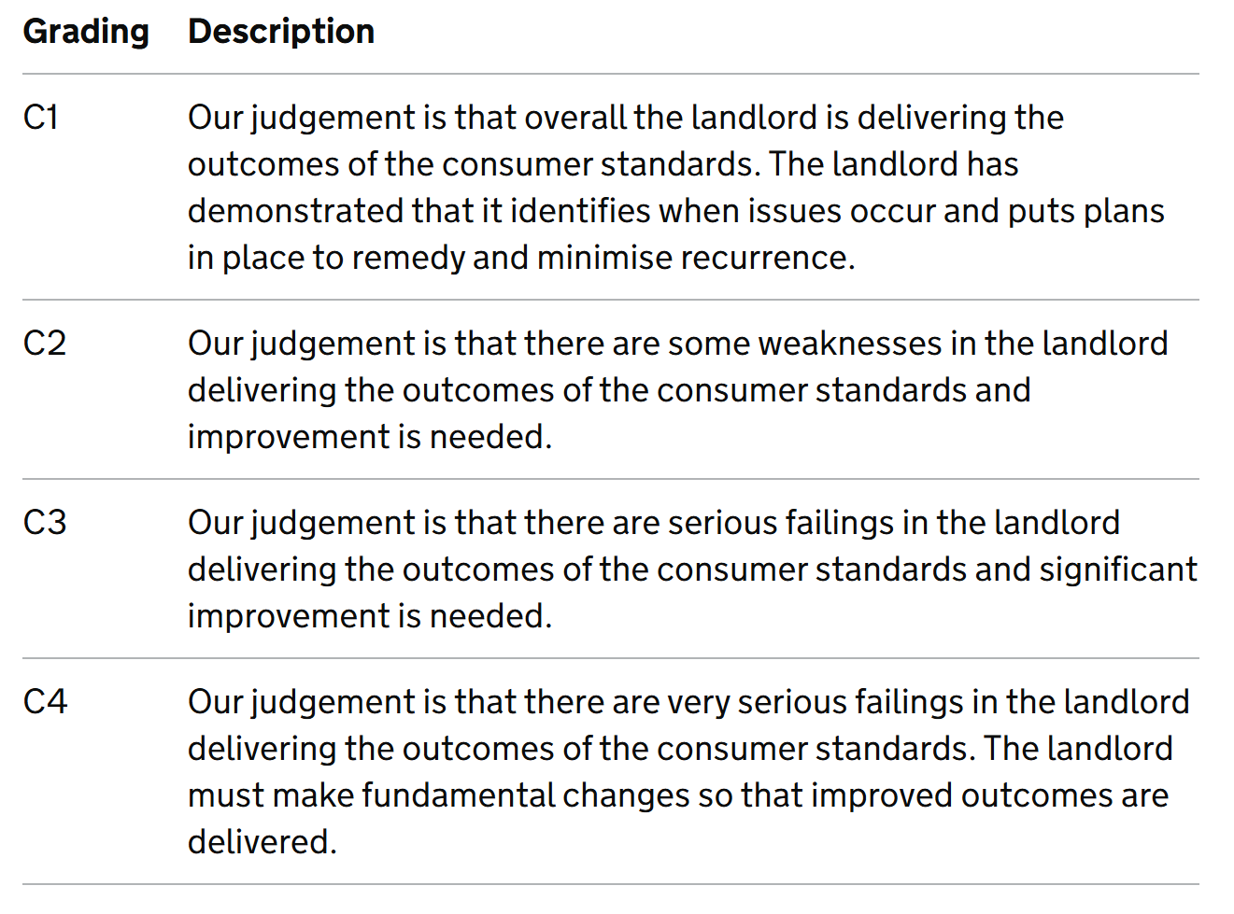
Regulatory Judgements and gradings

Slide 15
Questions, discussion and sharing

Slide 16
Governance and the role of the board

Slide 17

Governance & role of the board
    In practice
      delivery of strategic objectives
      how specific risks are managed
      key decisions are made
      good outcomes for tenants
    Regulatory standards & expected outcomes align with key governance principles
      responsibility – carrying out power & authority ethically
      accountability – explain use of that authority with honest information
      transparency – ‘being clear about historical performance and future intention’
      fairness – for all key stakeholders, with effective redress
Difference between compliance and governance
- ‘what is required’ v ‘how do we make this effective’
Charitable law, guidance and duties

Slide 18

NHF code 2020 requirements
Strategy and Delivery
The board:
sets the organisation’s overall direction and strategy in line with its charitable, community benefit or other constitutional purposes.
sets financially sustainable plans to ensure that the organisation has the resources it needs to deliver its strategy.
gives specific consideration in setting such plans to value for money, financial sustainability, …
exercises demonstrable and effective oversight of delivery.

Slide 19
Setting purpose and strategic aims and delivering it
    What is this organisation for
    Do we have clarity on our purpose and objectives?
    How do we decide how to use the organisation’s money to deliver our objectives?
    What are the trade offs and opportunity costs
    How will we know if we’ve achieved value for money (VFM) in delivering our strategy?
    Why are we doing what we are doing?
    If I was putting my own money at risk, would I do this?
    If I would, what return would I want?
    Is it delivering its medium and long term strategic aims?
Notes:
Registered providers shall ensure that they manage their affairs with an appropriate degree of skill, independence, diligence, effectiveness, prudence and foresight.

Slide 20
NHF code 2020 requirements
Risk management: control and assurance
The board:
actively manages the risks faced by the organisation, and obtains robust assurance that controls are effective, that plans and compliance obligations are being delivered
retains ultimate responsibility for risk management and ensures that appropriate risk management arrangements are in place
retains ultimate responsibility for the organisation’s compliance with all legal, statutory, regulatory and constitutional requirements.

Slide 21
Risk and assurance
Reassurance – opinion, trust
Assurance – information, evidence, triangulation (including with reassurance)
Assurance needed on: risks, data, controls, procedures, strategic and operational performance
‘Assurance mapping’ – what sources of assurance exist, how well do these cover risks. Examples of assurance:
      Management reports / KPIs
      Internal audits and ccompliance reviews
      Specialist advice (legal, treasury, H&S)
      Inspection outputs (e.g. CQC, regulatory judgements)
      Stress testing outputs and recovery planning
Rightsizing assurance: Scope, depth, desk-top, inspection, independent, management. If the data is wrong then assurances will be meaningless

Slide 22
‘Depth’ illustration: Governance arrangements managing H&S risks
    The risk assessment, documented controls and assurance map
    Coverage of risks - fire, electrical, asbestos, gas, legionella …
    Clarity of responsibility
    Board understanding of risks, documented controls and its assurance on them
    Sample of oversight performance reporting to the board or committee
    Recent third-party assurance:
      Data integrity
      Internal audit / specialist advise
      Frequency
      Coverage of risk areas
      Findings from audits and reviews - number and severity of recommendations
      Recommendation follow up
      Customer complaints
      CQC inspections

Slide 23
Regulatory expectations

Slide 24
Regulatory expectations
Governance and Financial Viability Standard
    2.3 Specific expectation on communicating with the regulator
    2.8 Specific expectation on assessing compliance with regulatory standards
  Governance and Financial Viability Code of Practice
    Paragraphs 19 & 20
  Transparency, Influence and Accountability Standard
    2.6 Specific expectation on self referral
  Consumer Standards Code of Practice
    Paragraph 57
Co-regulation

Slide 25
The regulator receives referrals from different sources
A referral is information, allegations, or complaints that tell us that a social housing landlord may not be delivering the outcomes of our standards.
Landlords
Tenants
Elected officials
Leaseholders / shared owners
Employees
Housing Ombudsman Service
Building Safety Regulator

Slide 26
How does it look in practice…
Data from RSH, Consumer Regulation Review 2023-24

Slide 27
Half of large landlords self-referred at least once in the last two years

Slide 28
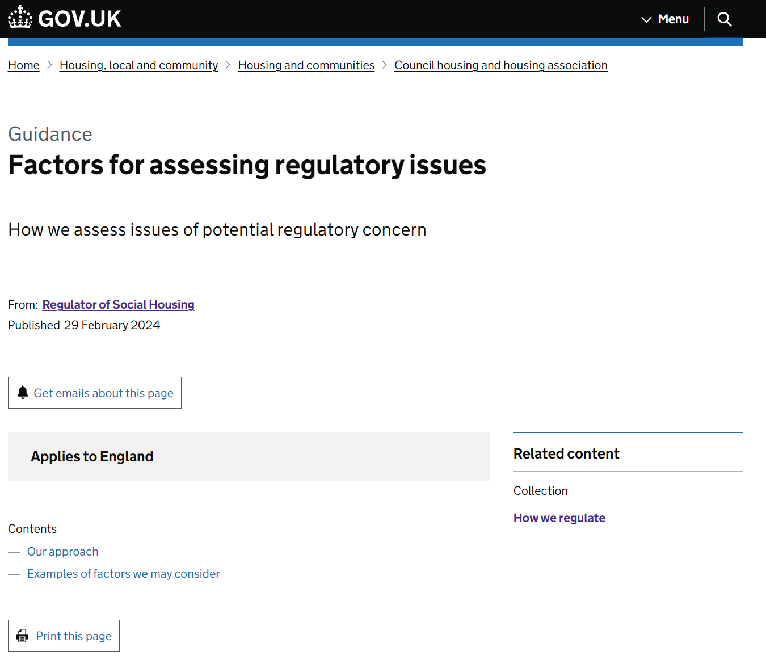
What we do with referrals
We look at every referral that comes into RSH.
We don’t necessarily take regulatory action on every referral.
  We can:
    Take no further action.
    Use the information for regulatory intelligence.
    Undertake regulatory engagement.
  We use data across our referrals to look at themes at provider and sector level.
Factors for assessing regulatory issues
Remit – whether the issues relate to our standards
Context – what our broader regulatory intelligence tells us
Scale and impact – who may be impacted by the issue and what the impact might be
Landlord actions – what actions the landlord has taken in response to the issue
Our statutory objectives and duties – including the things that our legislation requires us to have regard to

Slide 29
Themes from engagement
& lessons learnt…

Slide 30
Themes – consumer standards
Key role of landlords is to ensure tenants are safe in their home
Complexity of ownership / management arrangements
Improved data – stock condition and understanding of tenants.
Professional curiosity
Joining the dots on numerous sources of intelligence about homes and tenants’ experiences
Tenant engagement, governance and decision-making methods.
Availability of evidence - listening to tenants and acting on views

Slide 31
Themes – economic standards
Strategic value for money –with a purpose lens
Balancing priorities and trade offs
Importance of managing risks around viability – financial governance
Stress testing, mitigations, asset and liabilities records
Understanding structures and asking why – regular review.
Aligning assurance to risks, testing controls
Quality and adequacy of reporting to board on key risks.

Slide 32
Lessons learnt....leadership
    Weaknesses at Board or Executive level
    Weak Board and maverick Chief Executive
    Cosy relationships between Board and Executive
    Lack of challenge from the Board
    Instability at Board or Executive level
    Lack of management depth
    Failure to match experience and expertise with activities
    Poor relationships with key stakeholders

Slide 33
Lessons learnt.....delivery and risk management
    Poor quality Board reporting
    Ineffective Audit Committee
    Inadequate audit and assurance arrangements
    Failure to understand the key risks
    Insufficient focus on performance and compliance
    Inadequate financial information and reporting
    Late or inaccurate regulatory returns
    Serious findings in the audit management letter
    Whistleblowing and other allegations

Slide 34
In conclusion…

Slide 35
How do boards best work with the regulator
Co-regulatory, transparent and accountable
Clarity of organisation’s purpose and board’s role
High expectations for assurance on risky, complex, impactful areas
Ownership and use of data to really understand challenges
Can evidence that regulatory outcomes are being delivered
Notes:
Sector has a co-regulatory settlement and boards remain accountable for delivering good quality safe homes, effective services and treating their tenants with fairness and respect – for the most part it’s how you work when not engaged in an inspection that determine the best regulatory relationships.
Not just about the board, often see how committees are used, and quality of those either have a positive or negative impact on how effective the board is
When we do engage with you, we’re looking at what risks you need to manage to make sure the resources you use do deliver the best outcomes – risk / reward
In depth assessments are either 4 or 2-3 years frequency – what are you doing in those intervening years to make sure you can work well with us. Your org purpose, tenant priorities and role as leaders delivering on those is the driver and the ultimate preparation for meeting regulatory requirements. Have the higher expectation you can as a board for assurance in the areas you know pose most risk to tenants and to achieving your strategic objectives . Assurance underpinned with sources of evidence that can be relied on, reassurance is not appropriate for the level of oversight needed.
We use provider data in our regulation but the fact remains it is your data not ours. What is the point of collecting it if it doesn’t result in demonstrable action.
Experience from pilots, and from IDAs, is that it is not easy to evidence some of the outcomes in our standards. Ask the questions, spot the gaps, engage with tenants and direct the corrective action, don’t wait until an inspection.

Slide 36
Questions, discussion and sharing

