Slide 1
Hello and welcome to...
[Your name]

Slide 2
Today’s session covers:
What do we mean by equality and diversity?
Why’s it important in your day-to-day work?
What does the law require?
What can you do in your job role to promote equality and diversity?
We’ll be looking at:
Different forms of discrimination
Stereotyping and prejudices
Respect at work

Slide 3
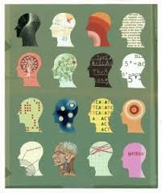
The situation
A builder, leaning out of a van, shouts ‘nice legs’ to a nurse cycling by. The same nurse arrives at work, and casually mentions this to a senior doctor. The doctor said, I’d never say that’.
The doctor has two grown up children who are 22 and 30. They get on very well. One is a sergeant in the army; the other is training to be a hairdresser. The doctor divorced last year and is currently dating someone.

Slide 4
Unconscious bias
Research shows that our brains jump to assumptions and conclusions without us even knowing it.
It applies to how we perceive other people.
Natural preferences for certain types of people- people like us
A process that bypasses our normal, rational and logical thinking- we don’t know we’re using it
A tool to allow us to sort people quickly into categories - we can then deal with them more quickly
The categories we use might not be logical or even legal

Slide 5
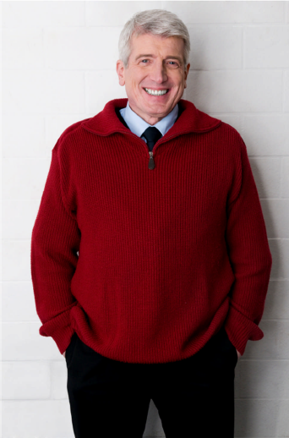
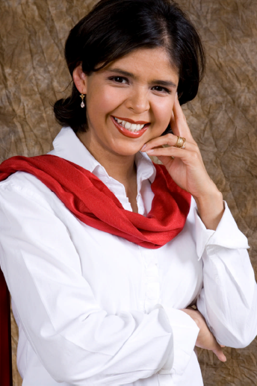
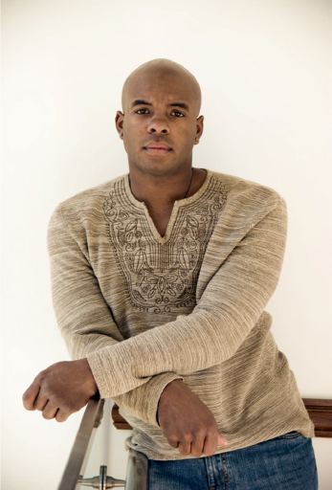
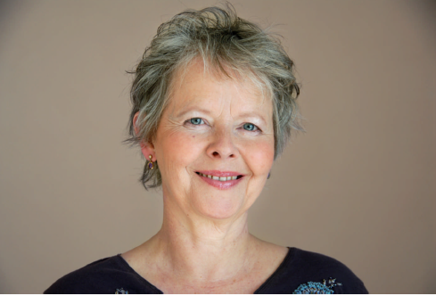

Slide 6
Implications
Who you spend more or less time with
Who you call on first for input/opportunities
Which customers/staff you have a ‘gut feeling’ about
Relationships with colleagues and team mates
Service provided to customers
Paying some people less attention
Talking to some people less warmly
Recruitment and promotion decisions
When in a majority group, remember the potential impact of unconscious bias on minority groups

Slide 7
“It’s just a bit of banter”
So where’s the line?
Notes:
7
Think about workplace banter… would it be ok to say those things in front of someone’s mother/children etc? would you feel the same if it happened to a loved one? If the public or tenants hear that what impression will they get? Does this sort of thing attract respect from other departments? etc

Slide 8
Banter – the bigger picture
Extermination
Physical Attack
Discrimination
Avoidance
Bad-mouthing
Adapted from Allport’s Scale of Prejudice
Notes:
1. Antilocution: Antilocution means a majority group freely make jokes about a minority group. Speech is in terms of negative stereotypes and negative images.^{[2]} This is also called hate speech.^{[3]} It is commonly seen as harmless by the majority. Antilocution itself may not be harmful, but it sets the stage for more severe outlets for prejudice (see also ethnic joke).
2. Avoidance: Members of the majority group actively avoid people in a minority group.^{[2]} No direct harm may be intended, but harm is done through isolation (see also social exclusion).
3. Discrimination: Minority groups are discriminated against by denying them opportunities and services, putting prejudice into action.^{[2]} Behaviors have the specific goal of harming the minority group by preventing them from achieving goals, getting education or jobs, etc. The majority group is actively trying to harm the minority. Examples are Jim Crow laws, Apartheid, treatment of Koreans in Japan.
4. Physical Attack: The majority group vandalize, burn or destroy minority group property and carry out violent attacks on individuals or groups.^{[2]} Physical harm is done to members of the minority group. Examples are lynchings of blacks, pogroms against Jews in Europe and British Loyalists in the 1700s.
5. Extermination: The majority group seeks extermination or removal of the minority group.^{[2]} They attempt to eliminate either the entire or a large fraction of a group of people (e.g., Indian Wars to remove Native Americans, the Final Solution to the "Jewish Question" in Nazi Germany, the Rwandan Genocide, and ethnic cleansing in the Bosnian War).

Slide 9
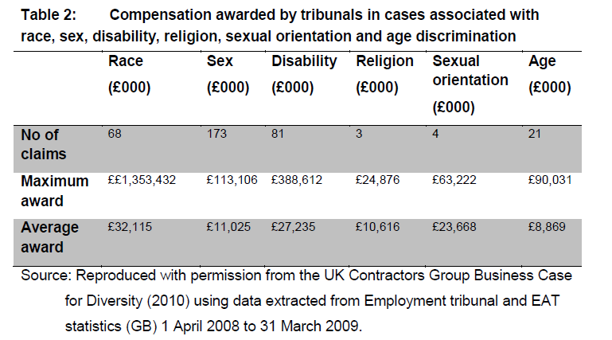
Costs and implications
Notes:
Equality and diversity: good practice for the construction sector
A report commissioned by the Equality and Human Rights Commission, 2011

Slide 10
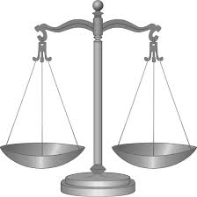
Equality Act 2010...
... simplifies equality law – replaces all existing Acts
including:
Equal Pay Act 1970
Sex Discrimination Act 1975
Race Relations Act 1976
Disability Discrimination Act 1995
... harmonises the law – providing the same levels of protection for people across all protected characteristics and identifying the behaviour that is unlawful
... strengthens the law in certain areas

Slide 11
Who’s protected?
The protected characteristics are:
Age
Disability
Gender reassignment
Marriage and civil partnership
Pregnancy and maternity
Race
Religion or belief
Sex
Sexual orientation

Slide 12
What are people protected against?
Direct discrimination
Discrimination by association and perception - new
Indirect discrimination
Harassment
Victimisation
- related to most areas of activity, against people with protected characteristics e.g. employment, housing, the provision of services and the exercise of public functions.

Slide 13
It’s not enough to ‘not discriminate’, there’s a need to:
understand the diversity of your communities, residents and staff, and their challenges / aspirations
respond to their different needs in employment & when designing and delivering services
engage with people so that services meet their needs
eliminate discrimination; advance equality of opportunity; foster good relations

Slide 14
Tenant Involvement and Empowerment standard
Understanding and responding to the diverse needs of tenants
Registered providers shall:
treat all tenants with fairness and respect
demonstrate that they understand the different needs of their tenants, including in relation to the equality strands and tenants with additional support needs

Slide 15
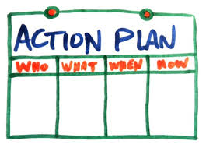
You are part of an team that has come together to raise awareness of, and tackle, discrimination and inequality:
In your team discuss the questions and agree an overall approach.
You need to create and present back to your colleagues either:
An action plan
A flyer/poster or web page
You need to convince your colleagues that your approach will work.

Slide 16
What have you thought...
Notes:
Evaluation & closing quote.

Slide 17
How people remember you
“I've learned that people
will forget what you said,
people will forget what you did,
but people will never forget
how you made them feel”
Maya Angelou
Thank-you
Notes:
Evaluation & closing quote.

